Slide 2
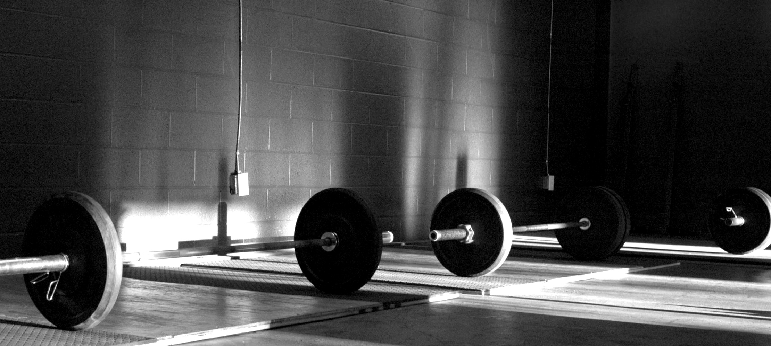
Exercise Amplifies Strength

Slide 3
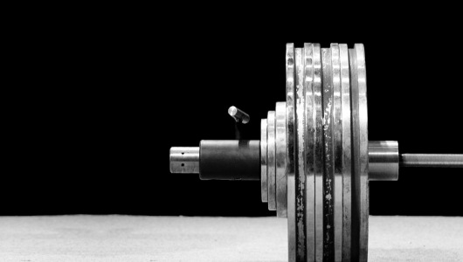
Exercise Amplifies Physical Strength
“For bodily exercise profits a little, but godliness is profitable for all things, having promise of the life that now is and of that which is to come. This is a faithful saying and worthy of all acceptance.”
1 Timothy 4:8-9

Slide 4
Exercise Amplifies Physical Strength
“If anyone defiles the temple of God, God will destroy him. For the temple of God is holy, which temple you are.”
1 Corinthians 3:17

Slide 5
Exercise Amplifies Mental Strength
“Be diligent to present yourself approved to God, a worker who does not need to be ashamed, rightly dividing the word of truth.”
2 Timothy 2:15

Slide 6
Exercise Amplifies Spiritual Strength
“But reject profane and old wives' fables, and exercise yourself toward godliness.”
1 Timothy 4:7

Slide 7
Exercise Amplifies Spiritual Strength
“But the fruit of the Spirit is love, joy, peace, longsuffering, kindness, goodness, faithfulness, gentleness, self-control. Against such there is no law.”
Galatians 5:22-23

Slide 8
Exercise Amplifies Strength
There are NO shortcuts

Slide 9
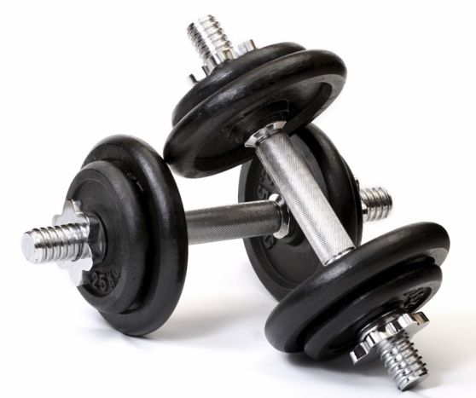
Exercise Amplifies Strength
There are NO shortcuts

Slide 10
Exercise Amplifies Strength
There are NO shortcuts

Slide 11
END

