Slide 2
ALWAYS DO YOUR BEST

Slide 3
“Blessed is the man who endures temptation; for when he has been approved, he will receive the crown of life which the Lord has promised to those who love Him.”
James 1:12

Slide 4
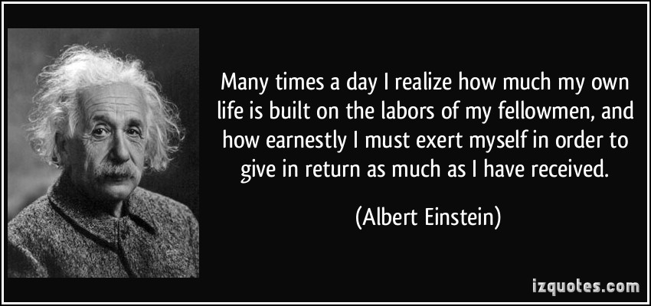

Slide 5
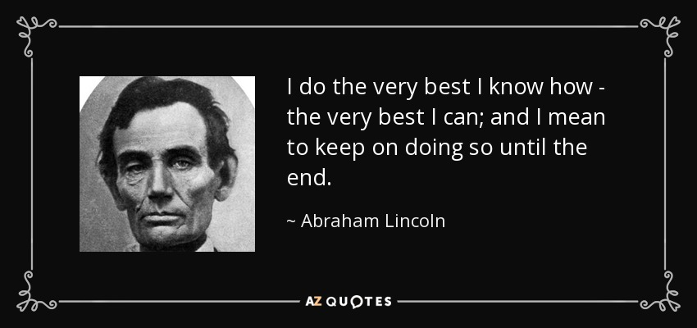

Slide 6
DOING OUR BEST IN EVERY SITUATION IS NOT EASY;
HOWEVER, IT IS THE RIGHT WAY TO LIVE.

Slide 7
WHY SHOULD I ALWAYS DO MY BEST?

Slide 8
WHY SHOULD I ALWAYS DO MY BEST?
WHERE DO YOU WANT TO BE
TODAY – TOMORROW – ETERNITY ?

Slide 9
“He has delivered us from the power of darkness and conveyed us into the kingdom of the Son of His love,”
Colossians 1:13

Slide 10
WHY SHOULD I ALWAYS DO MY BEST?
WHERE DO YOU WANT TO BE
TODAY – TOMORROW – ETERNITY ?

Slide 11
WE MUST ALWAYS HAVE A POSITIVE MINDSET

Slide 12
WE MUST ALWAYS HAVE A POSITIVE MINDSET
NO MATTER WHAT THE TASK WE MUST TELL OURSELVES TO DO OUR BEST

Slide 13
“I can do all things through Christ who strengthens me.”
Philippians 4:13

Slide 14
“Do all things without complaining and disputing,”
Philippians 2:14

Slide 15
“If anyone speaks, let him speak as the oracles of God. If anyone ministers, let him do it as with the ability which God supplies, that in all things God may be glorified through Jesus Christ, to whom belong the glory and the dominion forever and ever. Amen.”
1 Peter 4:11

Slide 16
“He who has a slack hand becomes poor, But the hand of the diligent makes rich.”
Proverbs 10:4

Slide 17
“The plans of the diligent lead surely to plenty, But those of everyone who is hasty, surely to poverty.”
Proverbs 10:4

Slide 18
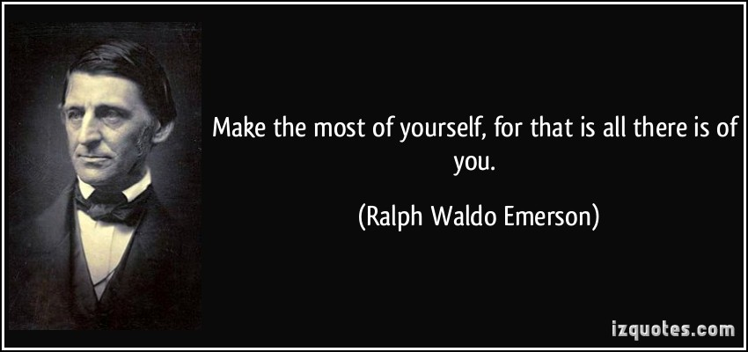

Slide 20
REACH YOUR FULL POTENTIAL

Slide 21
REACHING OUR FULL POTENTIAL
A MOTHER TOLD HER SON…
ENDEAVOR TO SO LIVE THAT WHEN YOU DIE, EVEN THE UNDERTAKER WILL BE SORRY.”

Slide 23
“Blessed is the man who endures temptation; for when he has been approved, he will receive the crown of life which the Lord has promised to those who love Him.”
James 1:12

Slide 25
END

