Slide 2
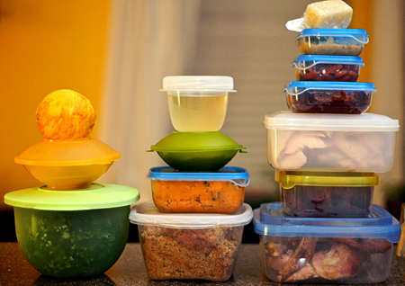
Giving God Our Leftovers

Slide 3
If God is not first in our life, then he will not be in our life!
Giving God Our Leftovers

Slide 4
TIME
It is our second most precious possession, second only to our soul!
Giving God Our Leftovers

Slide 5
MONEY
God’s portion
should come first,
off the top, not off the bottom!
Giving God Our Leftovers

Slide 6
ABILITY
AND
Many exhaust our energy and use their abilities in work, and then have little left for God!
Giving God Our Leftovers

Slide 7
LIFE
“Or do you not know that your body is the temple of the Holy Spirit who is in you, whom you have from God, and you are not your own? For you were bought at a price; therefore glorify God in your body and in your spirit, which are God’s.”
1 Corinthians 6:19-20
Giving God Our Leftovers

Slide 8
LIFE
Is Christ your life?
Giving God Our Leftovers

Slide 9
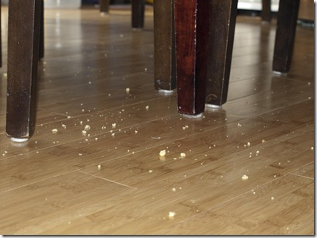
LOYALTY
TIME
MONEY
ENERGY
ABILITY
LIFE
God deserves, demands, and expects more than the crumbs that fall from life’s table!
Giving God Our Leftovers

Slide 10
END

