Slide 2
A Series of Lessons… LOOKING TO JESUS AS OUR EXAMPLE Lesson 2 – Knowledge & Obedience to the Scriptures

Slide 3
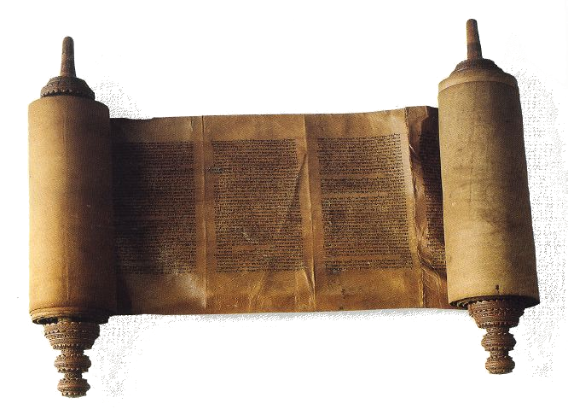
The Scriptures
“Jesus answered and said to them, "You are mistaken, not knowing the Scriptures nor the power of God.”
Matthew 22:29

Slide 4
The Scriptures
“Whoever commits sin also commits lawlessness, and sin is lawlessness.”
1 John 3:4

Slide 5
God Has Revealed All That Man Needs
“…as His divine power has given to us all things that pertain to life and godliness,…”
2 Peter 1:1-11

Slide 6
Jesus Knows That Our Salvation
Lies Within the Scriptures
“…And beginning at Moses and all the Prophets, He expounded to them in all the Scriptures the things concerning Himself.”
Luke 24:13-27

Slide 7
Jesus Knows That Our Salvation
Lies Within the Scriptures
“…These were more fair-minded than those in Thessalonica, in that they received the word with all readiness, and searched the Scriptures daily to find out whether these things were so. Therefore many of them believed, and also not a few of the Greeks, prominent women as well as men.”
Acts 17:11-12

Slide 8
Jesus Knows That Our Salvation
Lies Within the Scriptures
“For whoever does the will of My Father in heaven is My brother and sister and mother.”
Matthew 12:50

Slide 9
Jesus Used the Scriptures as His Guide
“But He answered and said, "It is written, 'Man shall not live by bread alone, but by every word that proceeds from the mouth of God.”
Matthew 4:4

Slide 10
Jesus Used the Scriptures as His Guide
“Jesus said to him, "It is written again, 'You shall not tempt the LORD your God.”
Matthew 4:7

Slide 11
Jesus Used the Scriptures as His Guide
“Then Jesus said to him, "Away with you, Satan! For it is written, 'You shall worship the LORD your God, and Him only you shall serve.”
Matthew 4:10

Slide 12
Jesus Used the Scriptures for Correction
“…And no one was able to answer Him a word, nor from that day on did anyone dare question Him anymore.”
Matthew 22:41-46

Slide 13
Jesus Used the Scriptures for Correction
“…"Woe to you, scribes and Pharisees, hypocrites! For you cleanse the outside of the cup and dish, but inside they are full of extortion and self-indulgence.”
Matthew 23:23-25

Slide 14
Jesus Obeyed the Will of His Father

Slide 15
Jesus Obeyed the Will of His Father
“Do not think that I came to destroy the Law or the Prophets. I did not come to destroy but to fulfill.”
Matthew 5:17

Slide 16
Jesus Obeyed the Will of His Father
“He went a little farther and fell on His face, and prayed, saying, "O My Father, if it is possible, let this cup pass from Me; nevertheless, not as I will, but as You will.”
Matthew 26:39

Slide 17
Jesus Obeyed the Will of His Father
“…For He shall bear their iniquities.”
Isaiah 53:3-11

Slide 18
“For through Him we both have access by one Spirit to the Father.”
Ephesians 2:18

Slide 19
“and from Jesus Christ, the faithful witness, the firstborn from the dead, and the ruler over the kings of the earth. To Him who loved us and washed us from our sins in His own blood, and has made us kings and priests to His God and Father, to Him be glory and dominion forever and ever. Amen.”
Revelation 1:5-6

Slide 20
A Series of Lessons… LOOKING TO JESUS AS OUR EXAMPLE Lesson 2 – Knowledge & Obedience to the Scriptures

Slide 21
A Series of Lessons…
LOOKING TO JESUS AS OUR EXAMPLE Lesson 2 – Knowledge & Obedience to The Scriptures

