Slide 2
A Series of Lessons… LOOKING TO JESUS AS OUR EXAMPLE Lesson 4 – Forgiveness

Slide 3
Christ & Forgiveness
“Then Jesus said, "Father, forgive them, for they do not know what they do.”
Luke 23:34

Slide 4
Christ & Forgiveness
“When Jesus had raised Himself up and saw no one but the woman, He said to her, "Woman, where are those accusers of yours? Has no one condemned you?" She said, "No one, Lord." And Jesus said to her, "Neither do I condemn you; go and sin no more.”
John 8:10-11

Slide 5
Christ & Forgiveness
“bearing with one another, and forgiving one another, if anyone has a complaint against another; even as Christ forgave you, so you also must do.”
Colossians 3:13

Slide 6
Christ Gives Us A Reason to Forgive
“For if you forgive men their trespasses, your heavenly Father will also forgive you. "But if you do not forgive men their trespasses, neither will your Father forgive your trespasses.”
Matthew 6:14-15

Slide 7
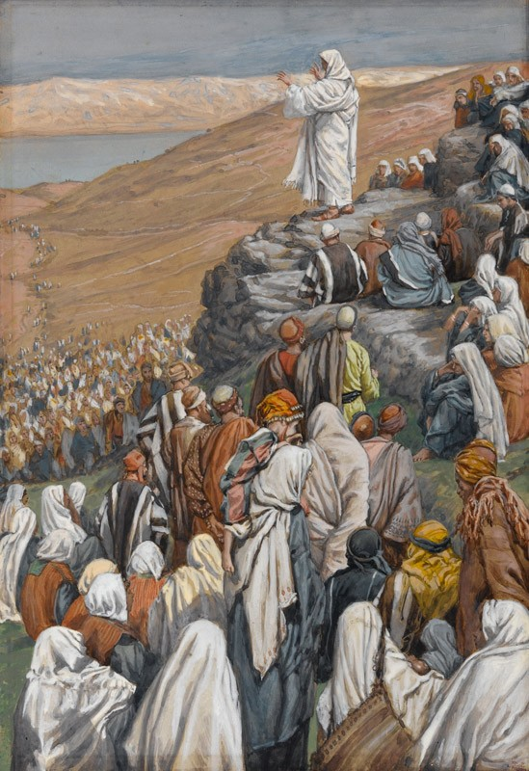
Christ Taught
on Forgiveness
Heaven is like a Certain King
Matthew 18:21-35

Slide 8
Christ Taught
on Forgiveness
“Therefore I say to you, her sins, which are many, are forgiven, for she loved much. But to whom little is forgiven, the same loves little."
Luke 7:47

Slide 9
Jesus Saw The Father Exemplify the Ability to Forgive
“But to Israel he says: "All day long I have stretched out My hands To a disobedient and contrary people.”
Romans 10:21

Slide 10
Jesus Saw The Father Exemplify the Ability to Forgive
“who desires all men to be saved and to come to the knowledge of the truth.”
1 Timothy 2:4

Slide 11
Jesus Saw The Father Exemplify the Ability to Forgive
“The Lord is not slack concerning His promise, as some count slackness, but is longsuffering toward us, not willing that any should perish but that all should come to repentance.”
2 Peter 3:9

Slide 12
Jesus Saw The Father Exemplify the Ability to Forgive
“Or do you despise the riches of His goodness, forbearance, and longsuffering, not knowing that the goodness of God leads you to repentance?”
Romans 2:4

Slide 13
We Need to Embrace the
Ability to Forgive

Slide 14
How easy or hard is it for you to follow Christ’s example to forgive?

Slide 15
A Series of Lessons… LOOKING TO JESUS AS OUR EXAMPLE Lesson 4 – Forgiveness

Slide 16
A Series of Lessons…
LOOKING TO JESUS AS OUR EXAMPLE Lesson 4 – Forgiveness

