Slide 3
THE RICH FOOL
---------------------------
Luke 12:18-19
"So he said, 'I will do this: I will pull down my barns and build greater, and there I will store all my crops and my goods. 'And I will say to my soul, "Soul, you have many goods laid up for many years; take your ease; eat, drink, and be merry.“’

Slide 4
THE RICH FOOL
---------------------------
Luke 12:18-21
"So he said, 'I will do this: I will pull down my barns and build greater, and there I will store all my crops and my goods. 'And I will say to my soul, "Soul, you have many goods laid up for many years; take your ease; eat, drink, and be merry."' "But God said to him, 'Fool! This night your soul will be required of you; then whose will those things be which you have provided?' "So is he who lays up treasure for himself, and is not rich toward God.”

Slide 6
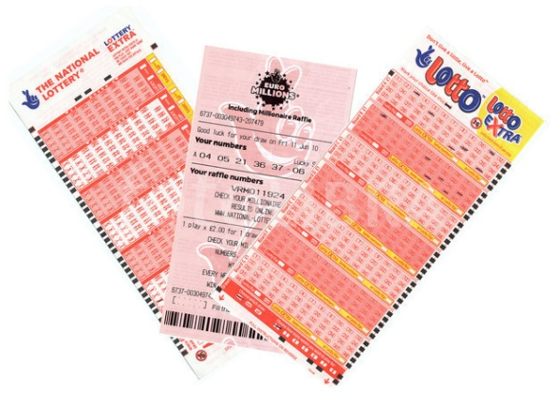
GAMBLING
---------------------------
To play a game for money or another stake; Hence to take money or other things of value upon an uncertain event; to hazard; to wager

Slide 7
GAMBLING
---------------------------
To play a game for money or another stake; Hence to take money or other things of value upon an uncertain event; to hazard; to wager
2 Essential Elements:
---------------------------
The Stake – One wins at another’s expense
The Element of Chance – If you play there is a chance you will win or lose

Slide 9
IT’S NOT THAT HARD!
---------------------------
Matthew 11:25-30

Slide 10
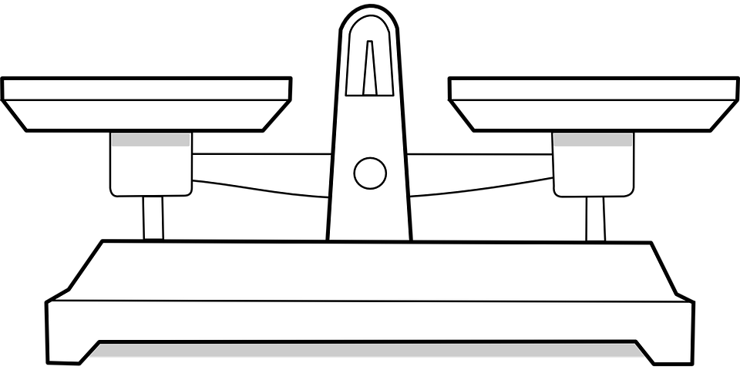
TODAY’S REWARD IS MAXIMIZED WITH BALANCE IN OUR LIVES

Slide 11
TODAY’S REWARD IS MAXIMIZED WITH BALANCE IN OUR LIVES
GOD
FIRST

Slide 12
TODAY’S REWARD IS MAXIMIZED WITH BALANCE IN OUR LIVES
FAMILY
NEXT

Slide 13
TODAY’S REWARD IS MAXIMIZED WITH BALANCE IN OUR LIVES
CAREER
AFTER

Slide 14
TOMORROW’S REWARD
-------------------------
John 14:1-4
HEAVEN
HOME

Slide 15
“as His divine power has given to us all things that pertain to life and godliness, through the knowledge of Him who called us by glory and virtue, by which have been given to us exceedingly great and precious promises, that through these you may be partakers of the divine nature, having escaped the corruption that is in the world through lust.”
2 Peter 1:3-4

