Slide 2
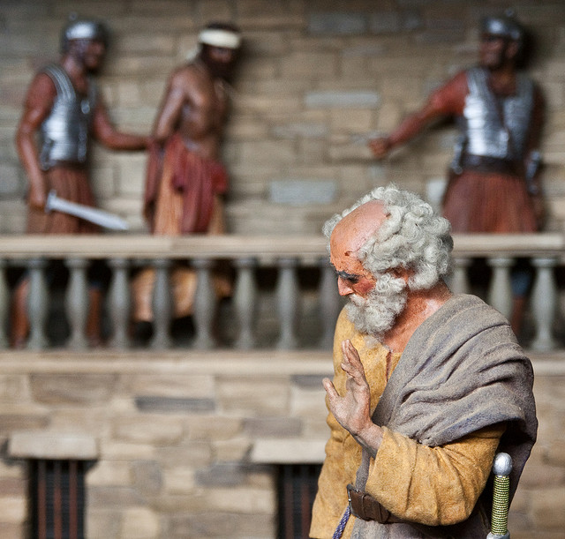
THE
AGONY
of
PETER
Matt. 26:75

Slide 3
Who is this bitterly weeping?
The same Peter that saw the transfiguration
The same Peter that drew his sword to defend Jesus
The same peter had said he would die for Jesus
Why is Peter weeping so bitterly?
Remembered his Lord’s words (v34)
Realized what he had done (vv. 69-74)

Slide 4
The Agony of Peter
He Got Too Sure of Himself (vv. 33-35)
Danger of Overconfidence
Paul confident, but cautious
Paul warned the Corinthians – “Flee Idolatry”

Slide 5
The Agony of Peter
He Got Too Far From Jesus (vv. 57-58)
Too far to be clearly identified with his Lord
To far to draw strength from his Lord
To far to really serve his Lord
To far to defend his Lord

Slide 6
The Agony of Peter
He Got Too Close to Sinners (vv. 69)
He placed himself in a position conducive to denying his Lord
He cast his influence with enemies of Christ under pressure

Slide 7
The Agony of Peter
He Got Too Close to Sinners (vv. 69)
He cast his influence with enemies of Christ under pressure
The pressure of Persecution
The pressure of Popularity
The pressure of Peace
The pressure of Conformity
The pressure of Ease
The pressure of Materialism

Slide 8
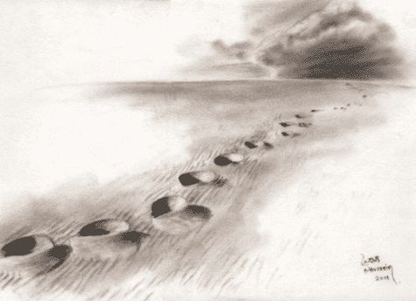
The Agony of Peter
If you are a Christian,
follow Jesus closely
If you are not a Christian…
begin by following
Him today!

Slide 9
THE
AGONY
of
PETER
Matt. 26:75

