Slide 2
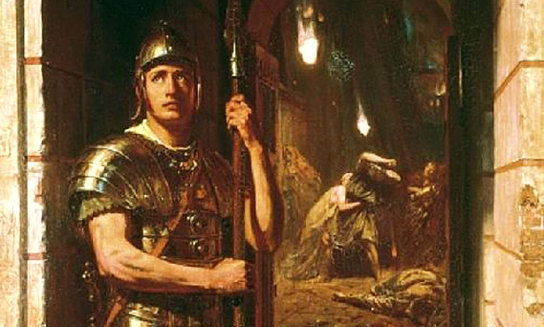
UNTIL DEATH
Acts 23:12-13

Slide 3
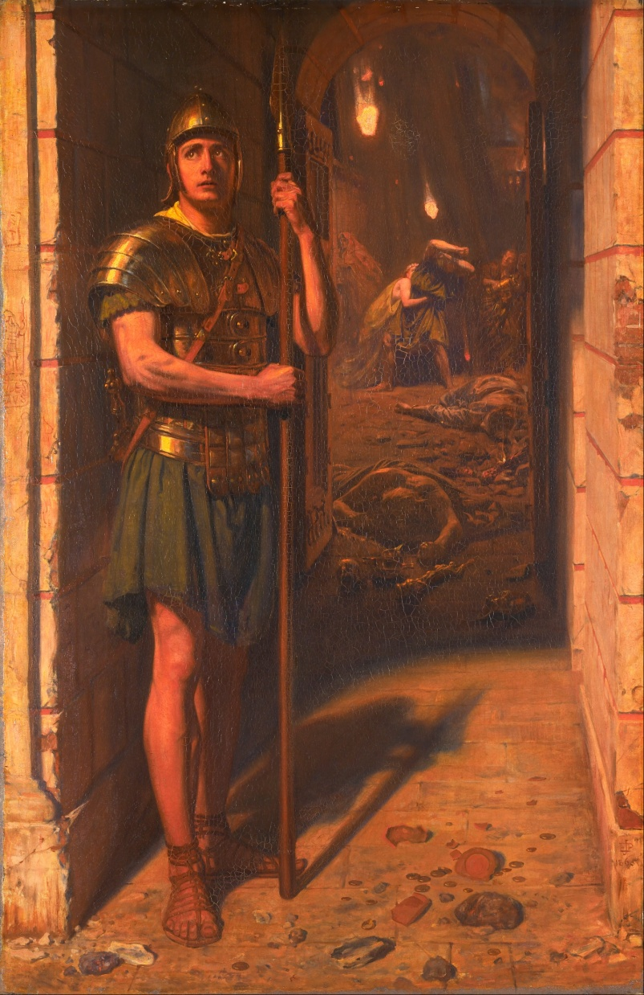
“They will put you out of the synagogues; yes, the time is coming that whoever kills you will think that he offers God service.”
John 16:2

Slide 4
APOSTLE PAUL
Raised a Pharisee
He was one who “thought he offered God service”
The Lord chose him – “vessel”
“to bear my name before the Gentiles, and kings, and the children of Israel” - Acts 9:15

Slide 5
APOSTLE PAUL
On the run
“I will show him how many things he must suffer for my name’s sake”
Light afflictions
2 Corinthians 11:23-33

Slide 6
APOSTLE PAUL
Plotting Paul’s death
Acts 9:20-26
Jerusalem – same results
Acts 23:12-15
Rome - final destination

Slide 7
Are We Committed to God
“Until Death?”

Slide 8
Are We Committed to God
“Until Death?”
“For I am already being poured out as a drink offering, and the time of my departure is at hand. I have fought the good fight, I have finished the race, I have kept the faith. Finally, there is laid up for me the crown of righteousness, which the Lord, the righteous Judge, will give to me on that Day, and not to me only but also to all who have loved His appearing.”
2 Timothy 4:6-8

