Slide 2
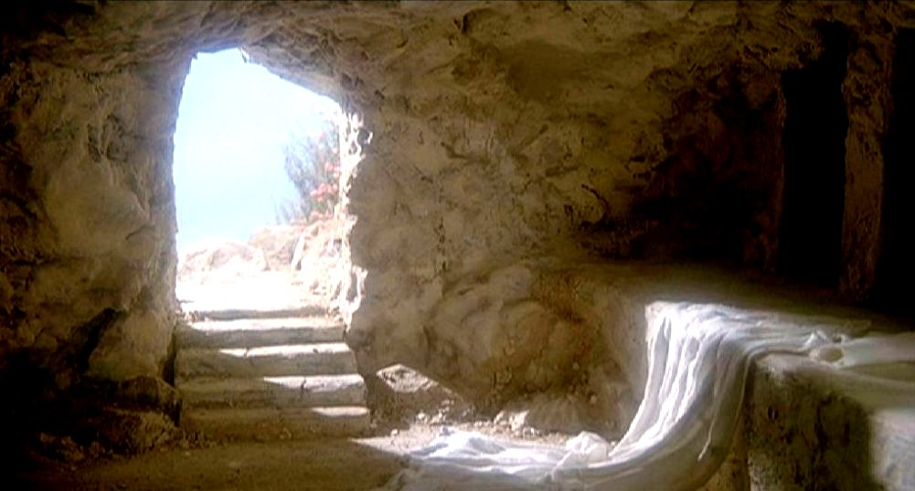
VICTORY OVER DEATH

Slide 3
“And I will put enmity Between you and the woman, And between your seed and her Seed; He shall bruise your head, And you shall bruise His heel.”
Genesis 3:15

Slide 4
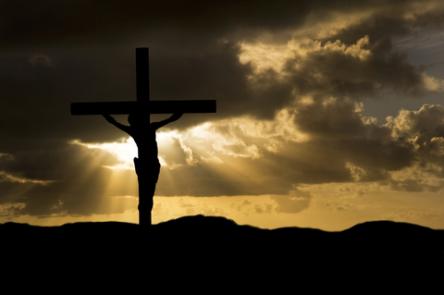
NECESSITY OF THE PURE SACRIFICE

Slide 5
RESURRECTIONS THROUGHOUT THE BIBLE

Slide 6
Biblical Accounts of People Raised from the Dead
 | Event | Scripture
1 | Elijah raised the son of the Zarephath widow from the dead | 1Kings 17:17-22
2 | Elisha raised the son of the Shunamite woman from the dead | 2Kings 4:32-35
3 | A man raised from the dead when his body touched Elisha's bones | 2Kings 13:20-21
4 | Jesus raised the son of the widow of Nain from the dead | Luke 7:11-15
5 | Jesus raised the daughter of Jairus from the dead | Luke 8:41-42; 49-55
6 | Jesus raised Lazarus from the dead | John 11:1-44
7 | Peter raised Dorcas from the dead | Acts 9:36-41
8 | Eutychus was raised from the dead by Paul | Acts 20:9-10
9 | Many saints rose from the dead at the death of Jesus | Matthew 27:50-53
10 | Jesus rose from the dead | Mat. 28:5-8; Mark 16:6; Luke 24:5-6

Slide 7
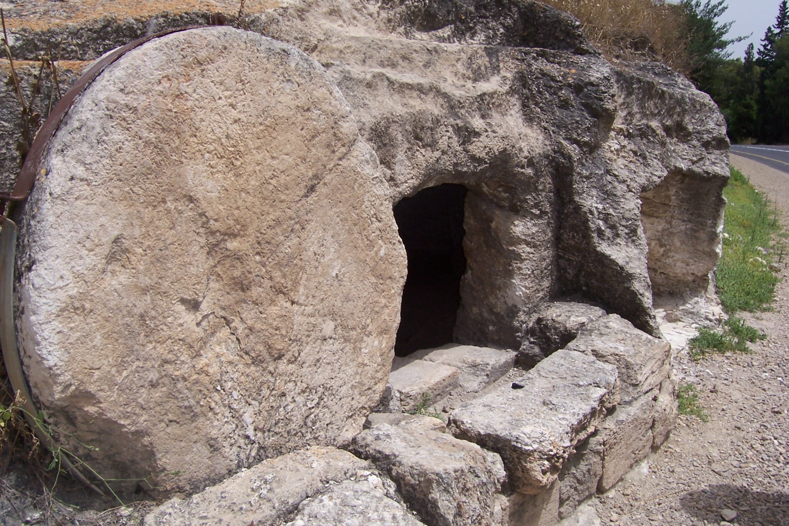
CHRIST’S BURIAL

Slide 8
CHRIST’S RESURRECTION

Slide 9
Appearances After His Resurrection
Order | Time | To Whom | Place | Scripture
1 | Early Sunday morning | Mary Magdalene | Near the tomb at Jerusalem | Mark 16:9 John 20:11-18
2 | Sunday morning | Women returning from the tomb | Near Jerusalem | Mat. 28:9-10
3 | Sunday | Simon Peter alone | Near Jerusalem | Luke 24:34
4 | Sunday afternoon | Two disciples going to Emmaus | Between Jerusalem & Emmaus, Jerusalem | Luke 24:13-31
5 | Sunday evening | Apostles, except Thomas | Jerusalem | John 20:19-25
6 | Sunday evening next week | Apostles, Thomas being present | Jerusalem | John 20:26-29
7 | Unknown | Seven disciples fishing | Sea of Galilee | John 21:1-13
8 | Unknown | Eleven disciples on mountain | Galilee | Mat. 28:16-20
9 | Unknown | About 500 brethren at once | Galilee | 1 Cor. 15:6
10 | Unknown | James only | Probably Jerusalem | 1 Cor. 15:7
11 | Unknown | All the apostles at ascension | Mount of Olives near Bethany | Luke 24:50-51 Acts 1:16-12

Slide 10
“And truly Jesus did many other signs in the presence of His disciples, which are not written in this book; but these are written that you may believe that Jesus is the Christ, the Son of God, and that believing you may have life in His name.”
John 20:30-31

