Slide 2
“SON OF CONSOLATION”

Slide 3
“And I also say to you that you are Peter, and on this rock I will build My church, and the gates of Hades shall not prevail against it.”
Matthew 16:18

Slide 4
“And he brought him to Jesus.
Now when Jesus looked at him, He said, “You are Simon the son of Jonah. You shall be called Cephas” (which is translated, A Stone).”
John 1:42

Slide 5
“James the son of Zebedee and John the brother of James, to whom He gave the name Boanerges, that is, “Sons of Thunder”
Mark 3:17

Slide 6
Barnabas
Member of the church in Jerusalem in earliest days
A Levite, companion to Paul
Prophet
Teacher
Apostle

Slide 7
Barnabas
Member of the church in Jerusalem in earliest days
Given name was Joseph
Surnamed by the apostles Barnabas (Acts 4:36)
Barnabas is a Hebrew name
Greek equivalent means “son of consolation”
“encouragement, exhortation, comfort”

Slide 8
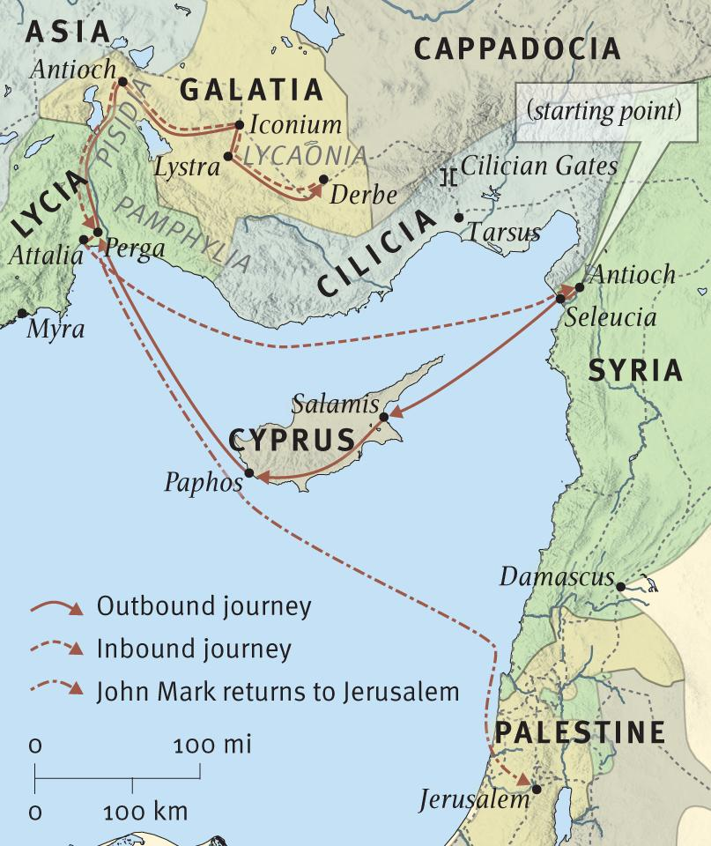
Barnabas
Influenced growth of the 1st century church
Cyprus
Antioch
Iconium
Lystra
Derbe
Antioch in Syria

Slide 9
Barnabas
Was a man of Generous Spirit

Slide 10
Barnabas
Was a man of Generous Spirit
“Or is it only Barnabas and I who have no right to refrain from working?”
1 Corinthians 9:6

Slide 11
Barnabas
Was a man of Generous Spirit
Was a “Son of Consolation” = Encouragement

Slide 12
Barnabas
Was a man of Generous Spirit
Was a “Son of Consolation” = Encouragement
“Then news of these things came to the ears of the church in Jerusalem, and they sent out Barnabas to go as far as Antioch. When he came and had seen the grace of God, he was glad, and encouraged them all that with purpose of heart they should continue with the Lord.”
Acts 11:22-23

Slide 13
Barnabas
Was a man of Generous Spirit
Was a “Son of Consolation” = Encouragement
“For he was a good man, full of the Holy Spirit and of faith. And a great many people were added to the Lord.”
Acts 11:24

Slide 14
Barnabas
Was a man of Generous Spirit
Was a “Son of Consolation” = Encouragement
“Then Barnabas departed for Tarsus to seek Saul. And when he had found him, he brought him to Antioch. So it was that for a whole year they assembled with the church and taught a great many people. And the disciples were first called Christians in Antioch.”
Acts 11:25-26

Slide 15
Barnabas
Was a man of Generous Spirit
Was a “Son of Consolation” = Encouragement
“And in these days prophets came from Jerusalem to Antioch. Then one of them, named Agabus, stood up and showed by the Spirit that there was going to be a great famine throughout all the world, which also happened in the days of Claudius Caesar…”
Acts 11:27-30

Slide 16
Barnabas
Was a man of Generous Spirit
Was a “Son of Consolation” = Encouragement
“Then the disciples, each according to his ability, determined to send relief to the brethren dwelling in Judea. This they also did, and sent it to the elders by the hands of Barnabas and Saul.”
Acts 11:27-30

Slide 17
Barnabas
Was a man of Generous Spirit
Was a “Son of Consolation” = Encouragement
“And Barnabas and Saul returned from Jerusalem when they had fulfilled their ministry, and they also took with them John whose surname was Mark.”
Acts 12:25

Slide 18
Barnabas
Was a man of Generous Spirit
Was a “Son of Consolation” = Encouragement
Worked with the Underdog

Slide 19
Barnabas
Was a man of Generous Spirit
Was a “Son of Consolation” = Encouragement
Worked with the Underdog
“And when Saul had come to Jerusalem, he tried to join the disciples; but they were all afraid of him, and did not believe that he was a disciple...”
Acts 9:26-28

Slide 20
Barnabas
Was a man of Generous Spirit
Was a “Son of Consolation” = Encouragement
Worked with the Underdog
“But Barnabas took him and brought him to the apostles. And he declared to them how he had seen the Lord on the road, and that He had spoken to him, and how he had preached boldly at Damascus in the name of Jesus...”
Acts 9:26-28

Slide 21
Barnabas
Was a man of Generous Spirit
Was a “Son of Consolation” = Encouragement
Worked with the Underdog
“So he was (Paul) with them at Jerusalem, coming in and going out.”
Acts 9:26-28

Slide 22
Barnabas
Was a man of Generous Spirit
Was a “Son of Consolation” = Encouragement
Worked with the Underdog
“Now when Paul and his party set sail from Paphos, they came to Perga in Pamphylia; and John, departing from them, returned to Jerusalem.”
Acts 13:13

Slide 23
Barnabas
Was a man of Generous Spirit
Was a “Son of Consolation” = Encouragement
Worked with the Underdog
“Then after some days Paul said to Barnabas, “Let us now go back and visit our brethren in every city where we have preached the word of the Lord, and see how they are doing...”
Acts 15:36-39

Slide 24
Barnabas
Was a man of Generous Spirit
Was a “Son of Consolation” = Encouragement
Worked with the Underdog
“Now Barnabas was determined to take with them John called Mark. But Paul insisted that they should not take with them the one who had departed from them in Pamphylia, and had not gone with them to the work...”
Acts 15:36-39

Slide 25
Barnabas
Was a man of Generous Spirit
Was a “Son of Consolation” = Encouragement
Worked with the Underdog
“Then the contention became so sharp that they parted from one another. And so Barnabas took Mark and sailed to Cyprus.”
Acts 15:36-39

Slide 26
Barnabas
Was a man of Generous Spirit
Was a “Son of Consolation” = Encouragement
Worked with the Underdog
“Aristarchus my fellow prisoner greets you, with Mark the cousin of Barnabas (about whom you received instructions: if he comes to you, welcome him),”
Colossians 4:10

Slide 27
Barnabas
Was a man of Generous Spirit
Was a “Son of Consolation” = Encouragement
Worked with the Underdog
“Only Luke is with me. Get Mark and bring him with you, for he is useful to me for ministry.”
2 Timothy 4:11

Slide 28
Barnabas
Was a man of Generous Spirit
Was a “Son of Consolation” = Encouragement
Worked with the Underdog
“Brethren, if a man is overtaken in any trespass, you who are spiritual restore such a one in a spirit of gentleness, considering yourself lest you also be tempted.”
Galatians 6:1

Slide 29
Barnabas
Was a man of Generous Spirit
Was a “Son of Consolation” = Encouragement
Worked with the Underdog
“Brethren, if anyone among you wanders from the truth, and someone turns him back, let him know that he who turns a sinner from the error of his way will save a soul from death and cover a multitude of sins.”
James 5:19-20

Slide 30
“SON OF CONSOLATION” HE SHOWS WHAT IT MEANS TO PUT THE KINGDOM FIRST

Slide 31
END

