Slide 3
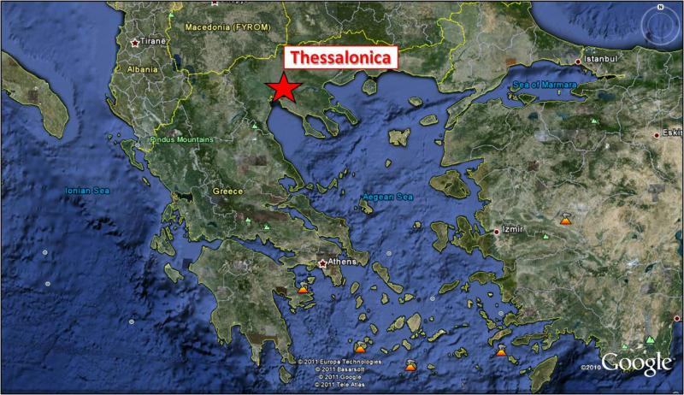
Great Example of Holy Living

Slide 4
Exhort:
to urge by earnest appeal, recommend strongly
Great Example of Holy Living

Slide 5
Authority of the Bible - ETHICS
Authority refers to “the power or right to act or command”
Ethics has reference to
A set of moral principles or values
The principles or conduct governing an individual or a group
“By what authority are you doing these things” And who gave you this authority?”
Matthew 21:23

Slide 6
Authority of the Bible - ETHICS
Authority refers to “the power or right to act or command”
Ethics has reference to
A set of moral principles or values
The principles or conduct governing an individual or a group
“pillar and ground of truth”
1 Timothy 3:15

Slide 7
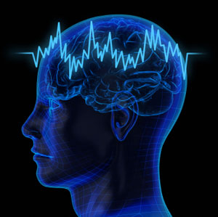
Human – SITUATIONAL ETHICS
Ethics means “a series of rules, laws, and principles by which we act and which tells us what to do”
Situation Ethics are not geared to rules and regulations
Flexibility in the application of moral laws according to circumstances
Nothing right or wrong – decision made on the situation at hand!

Slide 8
Human – SITUATIONAL ETHICS
Atheistic Situationism
Those who totally reject the scriptures as having any bearing on morality
Religious Situationism
Those who allege that the Bible actually endorses this code of action

Slide 9
Human – SITUATIONAL ETHICS
Atheistic Situationism
Those who totally reject the scriptures as having any bearing on morality
Wholly void of reason
Man is a self governing creature – cannot do wrong

Slide 10
Human – SITUATIONAL ETHICS
Religious Situationism
Those who allege that the Bible actually endorses this code of action
Love is the sole factor in making moral judgments
Self-contradictory

Slide 11
Human – SITUATIONAL ETHICS
Religious Situationism
Those who allege that the Bible actually endorses this code of action
Self-Contradictory…
This view contends that there are no rules except the rule of love. But what if, in a certain situation, one decides that love is not the appropriate course of action? According to the situationist, there are no absolutes – except that one absolutely must love in all situations.
What is the standard that this mandate is defended?

Slide 12
Human – SITUATIONAL ETHICS
Religious Situationism
Those who allege that the Bible actually endorses this code of action
Love is the sole factor in making moral judgments
Self-contradictory
Situationist’s “love” is purely subjective

Slide 13
Human – SITUATIONAL ETHICS
Religious Situationism
Those who allege that the Bible actually endorses this code of action
Love is Purely Subjective…
Situationist decides what love is in any given context. Situation ethics removes God from the throne as the moal sovereign of the universe, and substitutes man in His place. Situatinionism completely ignores the biblical view that mere mortals are void of sufficient wisdom to guide their earthly activity (Jer. 10:23)

Slide 14
Human – SITUATIONAL ETHICS
Religious Situationism
Those who allege that the Bible actually endorses this code of action
Love is the sole factor in making moral judgments
Self-contradictory
Situationist’s “love” is purely subjective
Ideology assumes that “love” is some sort of ambiguous, no-rule essence that is a cure-all for moral problems.

Slide 15
Human – SITUATIONAL ETHICS
Religious Situationism
Those who allege that the Bible actually endorses this code of action
Ideology…
This ideology assumes that “love” is some sort of ambiguous, no-rule essence that is the cure all for moral problems. That is like suggesting that two football teams play a game in which there will be no rules except “fairness.” BUT FAIRNESS COMPARED TO WHOSE JUDGEMENT?
Either team? Referees? Spectators? Sports Writers?
This would be nonsense!

Slide 16
Human – SITUATIONAL ETHICS
Religious Situationism
Those who allege that the Bible actually endorses this code of action
Love is the sole factor in making moral judgments
Self-contradictory
Situationist’s “love” is purely subjective
Ideology assumes that “love” is some sort of ambiguous, no-rule essence that is a cure-all for moral problems.
4) Situationism assumes a sort of infallible omniscience that is able to always precisely predict what the most “loving” course of action is.

Slide 17
Human – SITUATIONAL ETHICS
Religious Situationism
Those who allege that the Bible actually endorses this code of action
Infallible Omniscience…
Situationism assumes a sort of infallible omniscience that is able to always precisely predict what the most “loving” course of action is. For instance, the theory contends that lying, adultery, or even murder, could be “moral” if done in the context of love. Yet, who is able to foretell the consequences of such acts, and so determine, in advance, what is the “loving” thing to do?
GOD ONLY!

Slide 18
Human – SITUATIONAL ETHICS
Religious Situationism
Those who allege that the Bible actually endorses this code of action
Another Matter of Consideration…
During the first century, thousands of Christians were martyred for their faith. If the rule of situation ethics is valid, why could not those saints have lied, “denying the Lord who bought them” and thus rationalized that circumstance by arguing that the preservation of their lives would grant them more time to proclaim the gospel? If this concept/idea is true, the martyrs died in vain!

Slide 19
Authority of the Bible - ETHICS
“At that time Jesus went through the grainfields on the Sabbath. And His disciples were hungry, and began to pluck heads of grain and to eat. And when the Pharisees saw it, they said to Him, "Look, Your disciples are doing what is not lawful to do on the Sabbath!"But He said to them, "Have you not read what David did when he was hungry, he and those who were with him: how he entered the house of God and ate the showbread which was not lawful for him to eat, nor for those who were with him, but only for the priests?”
Matthew 12:1-4

Slide 20
Authority of the Bible - ETHICS
"Or have you not read in the law that on the Sabbath the priests in the temple profane the Sabbath, and are blameless? Yet I say to you that in this place there is One greater than the temple. But if you had known what this means, 'I desire mercy and not sacrifice,' you would not have condemned the guiltless. “For the Son of Man is Lord even of the Sabbath.”
Matthew 12:4-8

Slide 21
God is Always Correct in His Guidance
It is the standard that will establish the greatest good for all; not just now, but for eternity.

Slide 22
God is Always Correct in His Guidance
" O LORD, I know the way of man is not in himself; It is not in man who walks to direct his own steps.”
Jeremiah 10:23

Slide 23
God is Always Correct in His Guidance
" The way of a fool is right in his own eyes, But he who heeds counsel is wise.”
Proverbs 12:15

Slide 24
God is Always Correct in His Guidance
" Every way of a man is right in his own eyes, But the LORD weighs the hearts.”
Proverbs 21:2

Slide 25
God is Always Correct in His Guidance
" Who is wise? Let him understand these things. Who is prudent? Let him know them. For the ways of the LORD are right; The righteous walk in them, But transgressors stumble in them.”
Hosea 14:9

Slide 26
God is Always Correct in His Guidance
“Abstain from every form of evil.”
1 Thessalonians 5:22

Slide 27
God is Always Correct in His Guidance
In the coming of Christ “all authority” (Mt. 28:18) was given to Him by God, and that is why our only standard of moral authority for the exercise of moral rightness is found in the doctrine of Christ.
It is “The Word” that will judge. (John 12:48)

Slide 28
END

