Slide 2
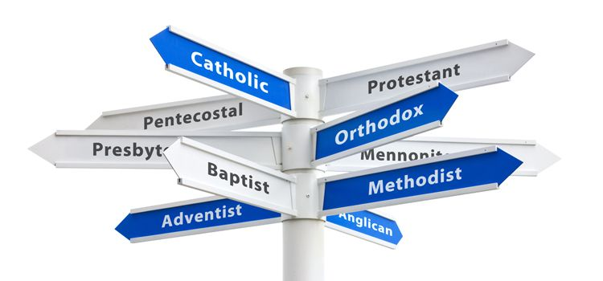
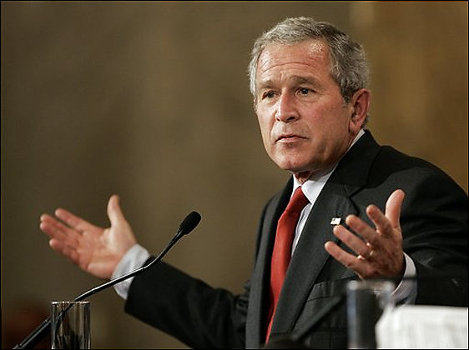
Denominationalism:
Is it all right? Is it all wrong? But he says… But she says…
I’m so confused!

Slide 3
What are we even talking about???
A religious denomination is a subgroup within a religion that operates under a common name, tradition, and identity.
The term refers to the various Christian denominations (for example, Eastern Orthodox, Roman Catholic, and the many varieties of Protestantism). It is also used to describe the four branches of Judaism (Orthodox, Conservative, Reform and Reconstructionist). Within Islam, it can refer to the branches or sects (such as Sunni, Shia, and Ahmadiyya), as well as their various subdivisions such as sub-sects, schools of jurisprudence, schools of theology and religious movements.
The world's largest religious denomination is Sunni Islam, followed by Roman Catholicism.

Slide 4
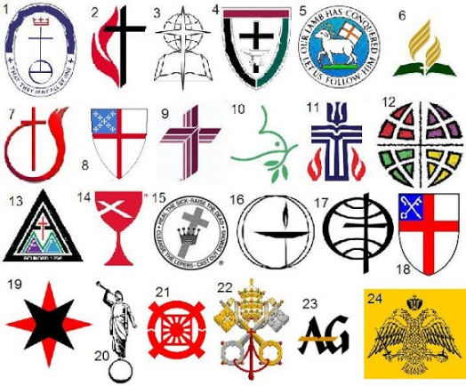
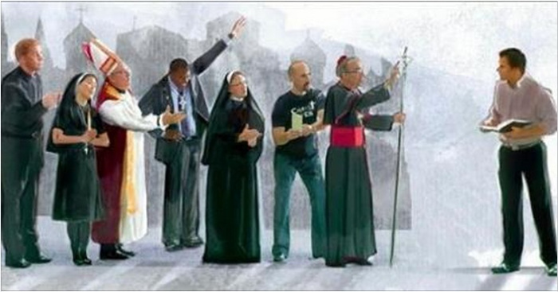
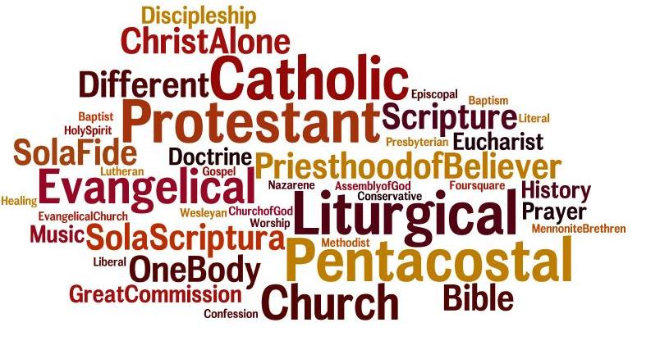
Different denominations can be good in terms of acceptable currency to use, home to reside, or pie to consume.
May not be good and acceptable for God.

Slide 5
Did God have a denominational view in His plans for the church?
It shall come to pass in the latter days that the mountain of the house of the Lord shall be established as the highest of the mountains, and shall be lifted up above the hills; and all the nations shall flow to it (Isaiah 2:2)
And in the days of those kings the God of heaven will set up a kingdom that shall never be destroyed, nor shall the kingdom be left to another people. It shall break in pieces all these kingdoms and bring them to an end, and it shall stand forever (Daniel 2:44)
And if a house is divided against itself, that house will not be able to stand. (Mark 3:25)

Slide 6
Did God have a denominational view in His plans for the church?
And I tell you, you are Peter, and on this rock I will build My church, and the gates of hell shall not prevail against it. (Matthew 16:18)
And I have other sheep that are not of this fold. I must bring them also, and they will listen to my voice. So there will be one flock, one shepherd. (John 10:16)
I do not ask for these only, but also for those who will believe in Me through their word, that they may all be one, just as You, Father, are in Me, and I in You, that they also may be in Us, so that the world may believe that You have sent Me. (John 17:20-21)

Slide 7
God had a plan for a united people, as preached by the apostles.
But now in Christ Jesus you who once were far off have been brought near by the blood of Christ. For He Himself is our peace, who has made us both one and has broken down in His flesh the dividing wall of hostility (Ephesians 2:13-14)
complete my joy by being of the same mind, having the same love, being in full accord and of one mind. (Phil. 2:2)
who gave himself for us to redeem us from all lawlessness and to purify for himself a people for his own possession who are zealous for good works. (Titus 2:14)
the life was made manifest, and we have seen it, and testify to it and proclaim to you the eternal life, which was with the Father and was made manifest to us— that which we have seen and heard we proclaim also to you, so that you too may have fellowship with us; and indeed our fellowship is with the Father and with His Son Jesus Christ. (1 John 1:2-3)

Slide 8
Although not specifically mentioned, denominationalism is taught against in the New Testament
I appeal to you, brothers, by the name of our Lord Jesus Christ, that all of you agree, and that there be no divisions among you, but that you be united in the same mind and the same judgment. For it has been reported to me by Chloe's people that there is quarreling among you, my brothers. What I mean is that each one of you says, “I follow Paul,” or “I follow Apollos,” or “I follow Cephas,” or “I follow Christ.” Is Christ divided? Was Paul crucified for you? Or were you baptized in the name of Paul? ( 1 Corinthians 1:10-13)
Is it any different to say, “I am Catholic,” or “I am Lutheran,” “I am Baptist,” “I am Methodist,” or “I am Methodist,” or “I am church of Christ?”

Slide 9
Now each denomination professes to follow the Bible, but we have differing doctrines
I am astonished that you are so quickly deserting Him who called you in the grace of Christ and are turning to a different gospel— not that there is another one, but there are some who trouble you and want to distort the gospel of Christ. (Galatians 1:6-7)
For the time is coming when people will not endure sound teaching, but having itching ears they will accumulate for themselves teachers to suit their own passions, and will turn away from listening to the truth and wander off into myths. (2 Timothy 4:3-4)
Beloved, do not believe every spirit, but test the spirits to see whether they are from God, for many false prophets have gone out into the world. (1 John 4:1)

Slide 10
While each group may be sincere, we can’t all be right. But we can certainly all be wrong!
Roman Catholicism
Eastern Orthodox
Baptists
Lutheran, Episcopal
Presbyterian, Pentecostals
Jehovah’s Witnesses, etc.

Slide 11
We need to be careful in our speech so that we are not hypocritical, and avoid a denominational mindset.
What do we say when we are asked what our religion is?
Do we describe ourselves as the rest of the denominational world? Do we make a distinction? Do we simply profess to be a Christian?
Observers may indict us of being hypocritical within the church of Christ (Mt. 23:13-14).
(Institutional/liberal v. Non-institutional/conservative churches)
Do we believe the church of Christ is the only one going to heaven?
While we believe only members of the One True Church will be saved, we can use this question as an opportunity to teach what the One True Church is.

Slide 12
Do we believe the church of Christ is the only one going to heaven?
The New Testament usually identifies the Church as a called out body without a specific, detailed title or name. Sometimes an alternate name is used to describe the Church and local congregations.
The Way (Acts 24:14)
The Bride of Christ (Rev. 21:9)
The churches of Christ (Romans 16:16)
The church of God (1 Corinthians 1:2)
The church/assembly of the firstborn (Hebrews 12:23)

Slide 13
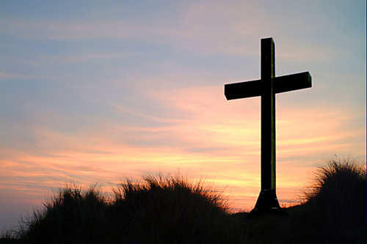
So who is going to heaven?
Ultimately it is God who will judge on the final day (Heb. 10:30).
The questions then become:
Am I obeying and doing what the Lord requires of salvation?
Am I a part of a congregation following the New Testament faithfully in all points?
Let us help you with your spiritual needs as we stand and sing!

