Slide 2
EVEN THOUGH
THE WORLD CHANGES…
LUKE 21:32-34

Slide 3
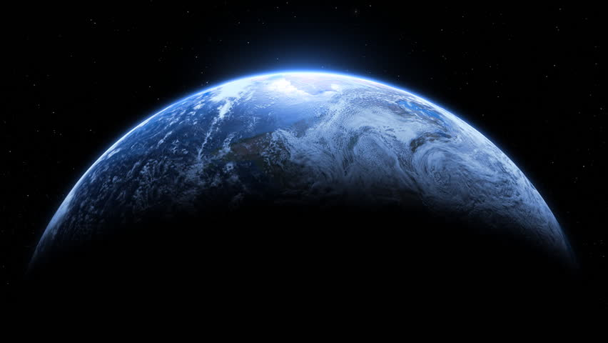
GOD’S WORD
"He who rejects Me, and does not receive My words, has that which judges him--the word that I have spoken will judge him in the last day.”
John 12:48

Slide 4
GOD’S WORD
"He who rejects Me, and does not receive My words, has that which judges him--the word that I have spoken will judge him in the last day.”
John 12:48

Slide 5
GOD’S WORD
"He who rejects Me, and does not receive My words, has that which judges him--the word that I have spoken will judge him in the last day.”
John 12:48

Slide 6
BIBLE
PROOFS
Q – Why should I believe the Bible is from God?

Slide 7
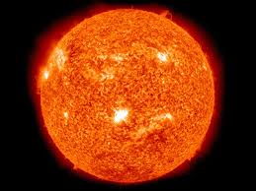
Scientists have concluded that there was light before the sun. This fact, though recently proven scientifically, is clearly shown in Gen. 1: 3 , 14-19.
Light was created on the first day while the sun was not in existence until the fourth.

Slide 8
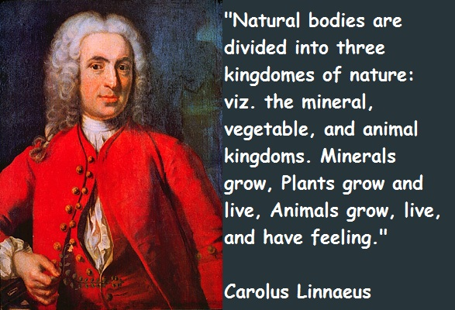
Genesis one, written by Moses about 1500 B.C., also contains a distinction in regard to the animal, vegetable, and mineral kingdoms.
Science did not know of such distinctions according to our records until 1735 with the writings of Linnaeus.

Slide 9
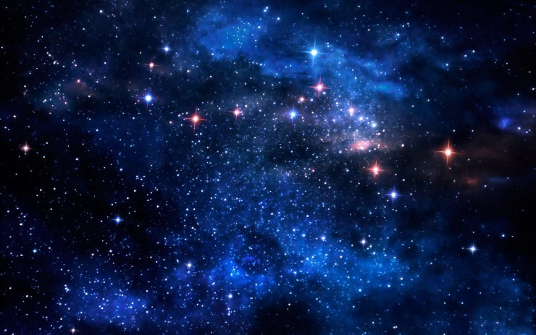
As late as 150 A.D. Ptolemy
believed that there were only
about 3000 stars. We now
know otherwise and the Bible
reported such in Gen. 13:16.
(Compare 15:5)

Slide 10
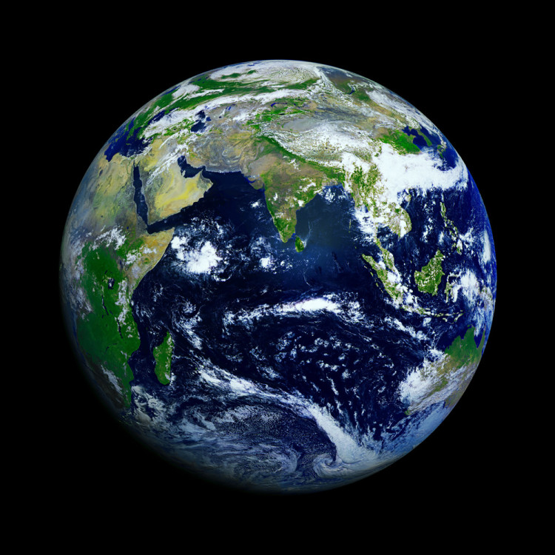
4. The rotundity of the earth was not understood until the early Grecians. Yet, the Bible reports this fact in Isa. 40:22
“It is He who sits above the circle of the earth, And its inhabitants are like grasshoppers, Who stretches out the heavens like a curtain, And spreads them out like a tent to dwell in”

Slide 11
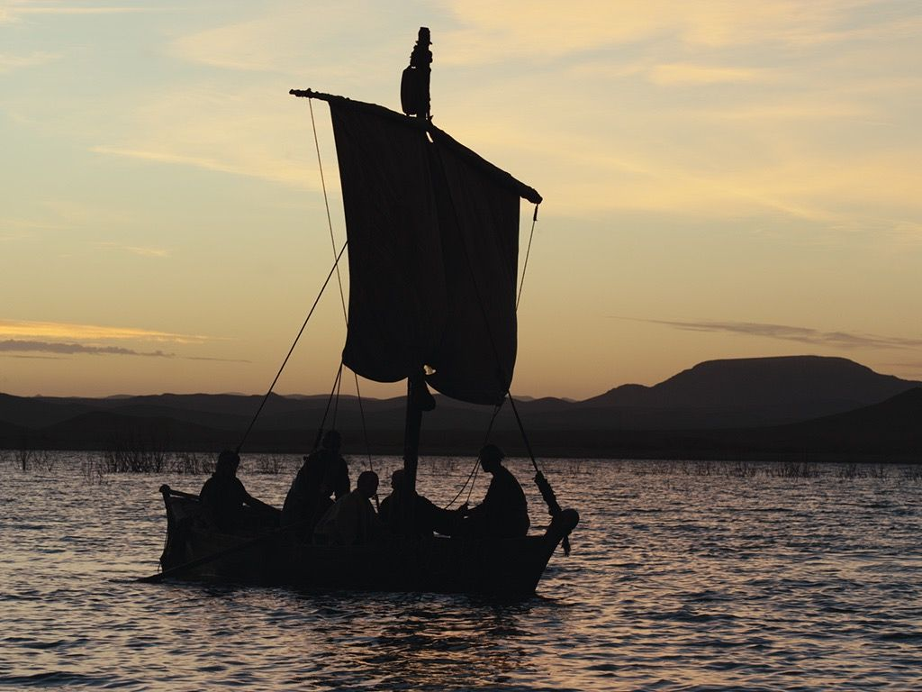
5. Not until men sailed around the earth did they understand the words of Job 26:7
“He stretches out the north over empty space; He hangs the earth on nothing.”

Slide 12
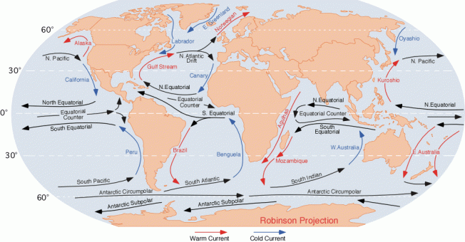
5. Oceanography (Paths in the sea), reported in Psalms 8, was not known by science until about 1850 and the writing of Matthew Maury.

Slide 13
PROPHESIES
FULLFILLED
Q – Why should I believe the Bible is from God?

Slide 14
The Messiah was to be born at Bethlehem (Micah 5:2).
The Messiah was to be preceded by a messenger (Isa. 40:3 and Mal. 3:1).
The Messiah was to enter Jerusalem riding a donkey (Zech. 9:9).
The Messiah was to be betrayed by a friend who ate with him (Psa. 41:9).
The Messiah was to be sold for 30 pieces of silver (Zech. 11:12).
The money was to be thrown into God's house and used for a potter's field (Zech.11:13).
The Messiah was to stand silent before his accusers (Isa. 53:7).
The Messiah was to die by crucifixion (Psa. 22:16; Zech. 12:10; Isa. 53:12).

Slide 15
THE BIBLE PROVES ITSELF TO BE!
Q – Why should I believe the Bible is from God?

Slide 16
HAS THE WORLD CHANGED?
YES
to some degree

Slide 17
HAS THE WORLD CHANGED?
NAMES CHANGE
not much else

Slide 18
EVEN THOUGH THE WORLD CHANGES…
GOD DOES NOT CHANGE

Slide 19
EVEN THOUGH THE WORLD CHANGES…
GOD DOES NOT CHANGE
“For I am the LORD, I do not change.”
Malachi 3:6

Slide 20
EVEN THOUGH THE WORLD CHANGES…
GOD DOES NOT CHANGE
"Heaven and earth will pass away, but My words will by no means pass away.”
Luke 21:33

Slide 21
EVEN THOUGH THE WORLD CHANGES…
GOD DOES NOT CHANGE
“I charge you therefore before God and the Lord Jesus Christ, who will judge the living and the dead at His appearing and His kingdom”
2 Timothy 4:1

Slide 22
EVEN THOUGH THE WORLD CHANGES…
GOD DOES NOT CHANGE
“But the word of the LORD endures forever." Now this is the word which by the gospel was preached to you.”
1 Peter 1:25

Slide 23
END

