Slide 2
Recipe to be a Positive Person

Slide 3
“Finally, brethren, whatever things are true, whatever things are noble, whatever things are just, whatever things are pure, whatever things are lovely, whatever things are of good report, if there is any virtue and if there is anything praiseworthy--meditate on these things”
Philippians 4:8

Slide 4
“Finally, brethren, whatever things are true, whatever things are noble, whatever things are just, whatever things are pure, whatever things are lovely, whatever things are of good report, if there is any virtue and if there is anything praiseworthy--meditate on these things”
Philippians 4:8

Slide 5
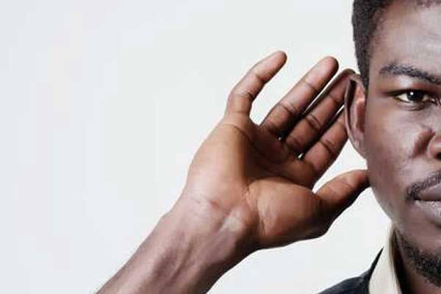
Hear Positive Sounds
“Then it was revealed in my hearing by the LORD of hosts, "Surely for this iniquity there will be no atonement for you, Even to your death," says the Lord GOD of hosts.”
Isaiah 22:14

Slide 6
See Positive Sights
“looking unto Jesus, the author and finisher of our faith, who for the joy that was set before Him endured the cross, despising the shame, and has sat down at the right hand of the throne of God.”
Hebrews 12:2

Slide 7
Speak Positive Words
“Sing to Him, sing psalms to Him; Talk of all His wondrous works!
Psalms 105.2

Slide 8
Perform
Positive Deeds
“And whatever you do, do it heartily, as to the Lord and not to men,”
Colossians 3:23

Slide 9
Attend Positive Places
“I was glad when they said to me, "Let us go into the house of the LORD.”
Psalms 122:1

Slide 11
END

