Slide 2
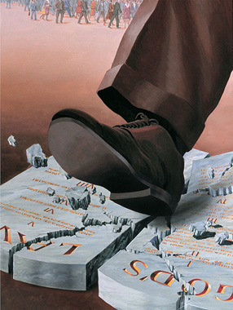
SINNING AGAINST GOD Genesis 39:7-9

Slide 3
SINNING AGAINST GOD
Sin Occurs When We Choose to Not Follow God’s Commands

Slide 4
SINNING AGAINST GOD
DAVID
Even though a great king, fell to temptation and disobeyed God

Slide 5
SINNING AGAINST GOD
DAVID
Even though a great king, fell to temptation and disobeyed God
Not go to war
Sent for Bathsheba
Laid with her

Slide 6
SINNING AGAINST GOD
DAVID
Even though a great king, fell to temptation and disobeyed God
Not go to war - Sent for Uriah
Sent for Bathsheba - Gave him drink
Laid with her - Had him killed

Slide 7
SINNING AGAINST GOD
DAVID
Even though a great king, fell to temptation and disobeyed God
Not go to war - Sent for Uriah
Sent for Bathsheba - Gave him drink
Laid with her - Had him killed
“I HAVE SINNED AGAINST THE LORD”

Slide 8
SINNING AGAINST GOD
JOSEPH
Appreciation of God Helped Him From Sinning Against God

Slide 9
SINNING AGAINST GOD
JOSEPH
Appreciation of God Helped Him From Sinning Against God
“No one greater in this house than I” v.9
Brothers sold him
Potiphar’s wife seduced him

Slide 10
SINNING AGAINST GOD
JOSEPH
Appreciation of God Helped Him From Sinning Against God
“No one greater in this house than I” v.9
Brothers sold him
Potiphar’s wife seduced him
“HOW THEN CAN I DO THIS GREAT WICKEDNESS AND SIN AGAINST GOD?”

Slide 11
SINNING AGAINST GOD
OURSELVES
Using Our Positions For Naught

Slide 12
SINNING AGAINST GOD
OURSELVES
Using Our Positions For Naught
Careers
Friends
Households

Slide 13
SINNING AGAINST GOD
OURSELVES
Using Our Positions For Naught
Why Would We Choose To Do This?
God Gives Us So Much!

Slide 14
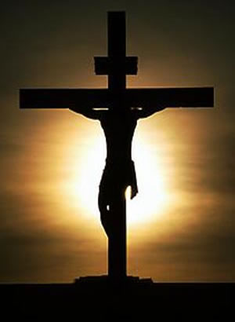
SINNING AGAINST GOD
OURSELVES
Using Our Positions For Naught
Why Would We Choose To Do This?
God Gives Us So Much!
WHY DO WE SIN AGAINST HIM?

Slide 15
SINNING AGAINST GOD
IF WE TRULY APPRECIATE GOD
then we must COMMIT ourselves

Slide 16
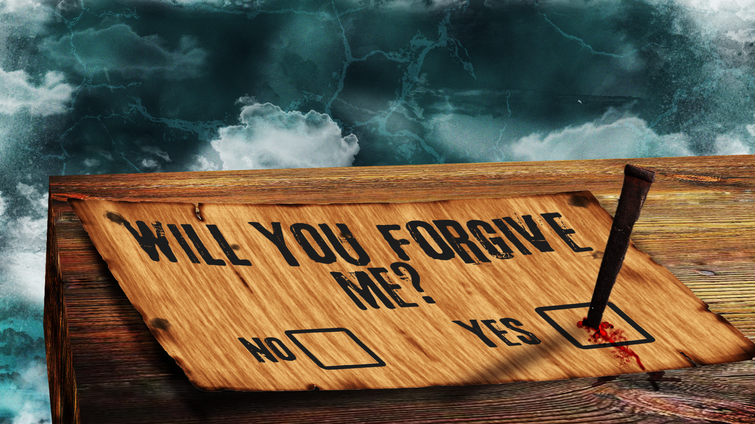
WE MUST ACKNOWLEDGE WHEN WE HAVE SINNED AGAINST GOD

Slide 17
END

