Slide 2
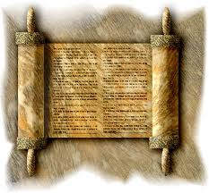
THE SANHEDRIN COUNCIL Who were these mighty men?

Slide 3
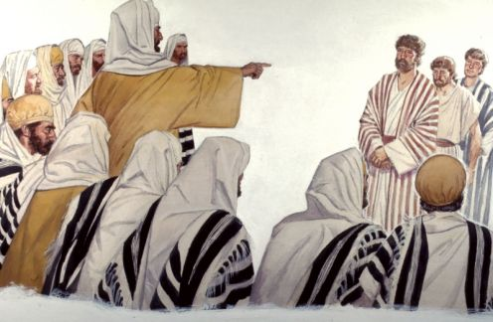
THE FORCE THAT TRIED SO HARD TO SUPRESS CHRIST AND HIS DISCIPLES…
God used their piousness, envy and pride to work His plan

Slide 4
THE FORCE THAT TRIED SO HARD TO SUPRESS CHRIST AND HIS DISCIPLES…
After being put to death, Christ continued to be extolled above these men

Slide 5
THE FORCE THAT TRIED SO HARD TO SUPRESS CHRIST AND HIS DISCIPLES…
SADDUCEES:
Heard the apostles declaring that Christ had risen from the dead and were “enraged”

Slide 6
THE FORCE THAT TRIED SO HARD TO SUPRESS CHRIST AND HIS DISCIPLES…
PHARISEES:
Were “angry” because they perceived the apostles teaching to undermine the Jewish ceremonies

Slide 7
THE FORCE THAT TRIED SO HARD TO SUPRESS CHRIST AND HIS DISCIPLES…
Together, they determined the work of the disciples should be stopped; it was proving them guilty of the death of Jesus!

Slide 8
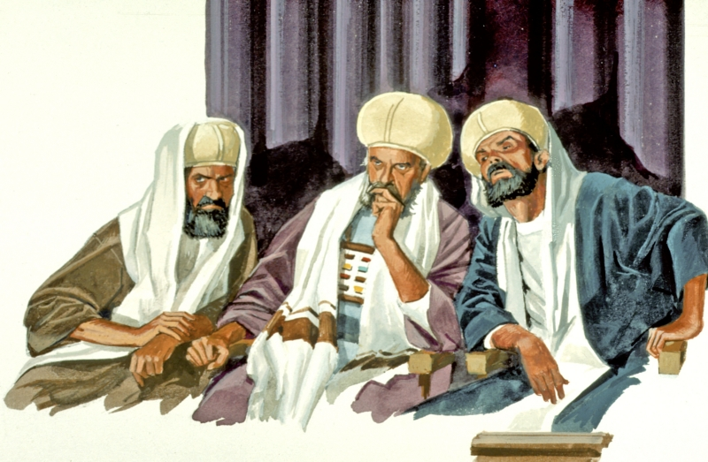
WHO WERE THESE MIGHTY MEN?
WHERE DID THEY COME FROM?
HOW DID THEY BECOME SO POWERFUL?

Slide 9
WHO WERE THESE MIGHTY MEN?
Roman Catholics traced signs (223 – 187 BC)
Jewish Library first records (57 BC)
The Sanhedrin Council was dismantled in the fall of Jerusalem and destruction of the Temple (70 AD)

Slide 10
WHO WERE THESE MIGHTY MEN?
In much of the time the Sanhedrin was assembled, they served under Greek rulers who allowed the Jews a large measure of self-government
After the death of Herod (4 BC) the council’s authority was limited to just Judea, Sodom, and Edom

Slide 11
WHO WERE THESE MIGHTY MEN?
Once Judea was annexed to the Roman province of Syria (6 AD) the Sanhedrin, under the control of procurators, became the supreme authority of the Jewish people
Only capital sentences pronounced by the council needed confirmation from the Roman officer before they could be carried into execution

Slide 12
WHERE DID THEY COME FROM?
Was there a pattern for such a legislative body in the scriptures?

Slide 13
WHERE DID THEY COME FROM?
It was recorded that the Sanhedrin was patterned after early scriptures…
“Now He said to Moses, "Come up to the LORD, you and Aaron, Nadab and Abihu, and seventy of the elders of Israel, and worship from afar. "And Moses alone shall come near the LORD, but they shall not come near; nor shall the people go up with him.”
Exodus 24:1-2

Slide 14
WHERE DID THEY COME FROM?
It was recorded that the Sanhedrin was patterned after early scriptures…
“So the LORD said to Moses: "Gather to Me seventy men of the elders of Israel, whom you know to be the elders of the people and officers over them; bring them to the tabernacle of meeting, that they may stand there with you. "Then I will come down and talk with you there. I will take of the Spirit that is upon you and will put the same upon them; and they shall bear the burden of the people with you, that you may not bear it yourself alone.”
Numbers 11:16-17

Slide 15
WHERE DID THEY COME FROM?
Meetings
The meetings took place in one of the chambers in the Temple, however in extraordinary cases they met at the house of the high priest

Slide 16
WHERE DID THEY COME FROM?
Meetings
The Great Sanhedrin met daily during the daytime, exceptions: The Sabbath, during festivals, or on festival eves
Were led by a president – nasi (prince)
vice president – av bet din (father of the court)

Slide 17
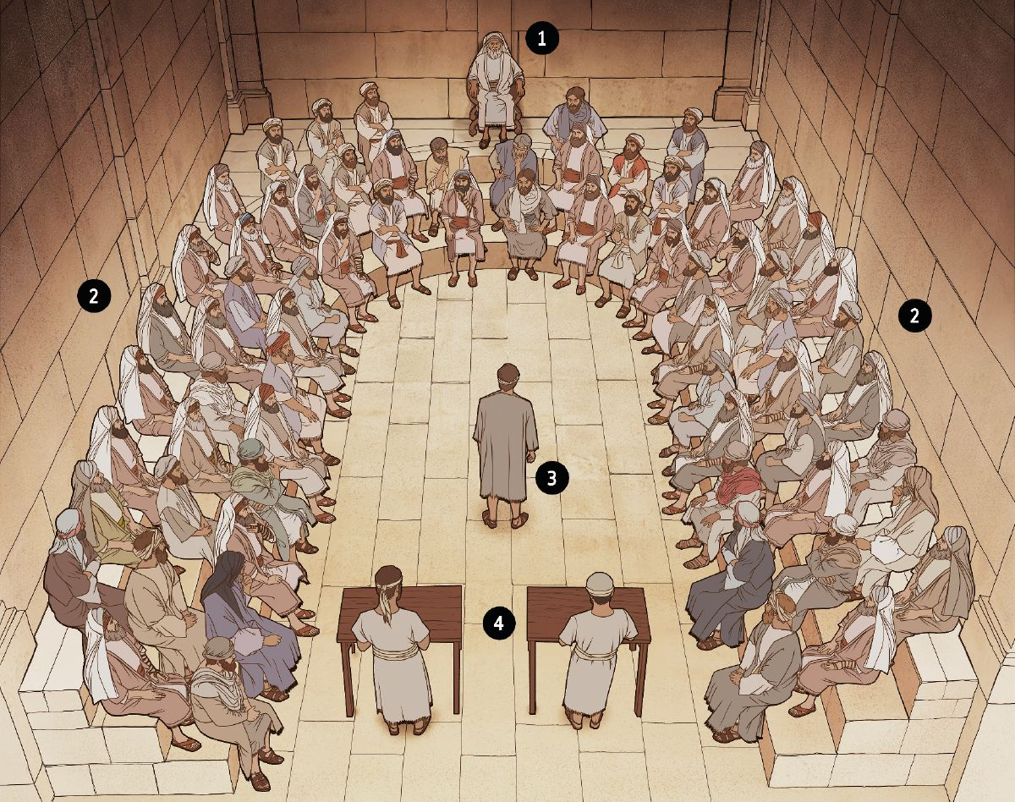

Slide 18
HOW DID THEY BECOME SO POWERFUL?
JURISDICTION
The council was connected with the minor courts being the highest court of capital appeal
Examples of what would come before the Sanhedrin:
Ritualistic matters, proceedings in connection to the discovery of a corpse, trials of adulterous wives, tithes, preparations of Torah scrolls for the king and the Temple, drawing up the calendar, and the identification and confirmation of the Messiah!

Slide 19
WHO WERE THESE MIGHTY MEN?
MEMBERS
There were three distinct classes
Chief priests, the scribes, and the ancients
Ancients: referred to those with maturity of age and respectability
Scribes: given to study of the law – Pharisees
Chief Priests: represented the high priesthood – Sadducees

Slide 20
WHO WERE THESE MIGHTY MEN?
UNETHICAL WAYS
Two most notable cases
Christ & the apostle Paul
Christ: they met to devise a plan to end their frustrations, needed false witnesses to move the case forward, took to Pilate to be tried for death
Paul: much different because Paul was a Pharisee, was a doctor of the law and knew the Sadducees stand on the resurrection

Slide 21
WHO WERE THESE MIGHTY MEN?
THE BELIEVERS OF CHRIST
Joseph of Arimathea:
“Joseph of Arimathea, a prominent council member, who was himself waiting for the kingdom of God, coming and taking courage, went in to Pilate and asked for the body of Jesus.”
Mark 15:43

Slide 22
WHO WERE THESE MIGHTY MEN?
THE BELIEVERS OF CHRIST
Joseph of Arimathea:
“Now when evening had come, there came a rich man from Arimathea, named Joseph, who himself had also become a disciple of Jesus. This man went to Pilate and asked for the body of Jesus. Then Pilate commanded the body to be given to him.”
Matthew 27:57-58

Slide 23
WHO WERE THESE MIGHTY MEN?
THE BELIEVERS OF CHRIST
Joseph of Arimathea:
“Now behold, there was a man named Joseph, a council member, a good and just man. He had not consented to their decision and deed. He was from Arimathea, a city of the Jews, who himself was also waiting for the kingdom of God. This man went to Pilate and asked for the body of Jesus.”
Luke 23:50-52

Slide 24
WHO WERE THESE MIGHTY MEN?
THE BELIEVERS OF CHRIST
Joseph of Arimathea:
“After this, Joseph of Arimathea, being a disciple of Jesus, but secretly, for fear of the Jews, asked Pilate that he might take away the body of Jesus; and Pilate gave him permission. So he came and took the body of Jesus.”
John 19:38

Slide 25
WHO WERE THESE MIGHTY MEN?
THE BELIEVERS OF CHRIST
Joseph of Arimathea:
Nicodemus:
“There was a man of the Pharisees named Nicodemus, a ruler of the Jews.”
John 3:1

Slide 26
WHO WERE THESE MIGHTY MEN?
THE BELIEVERS OF CHRIST
Joseph of Arimathea:
Nicodemus:
“Then they took the body of Jesus, and bound it in strips of linen with the spices, as the custom of the Jews is to bury.”.
John 19:40

Slide 27
THE SANHEDRIN COUNCIL Who were these mighty men?

Slide 28
END

