Slide 2
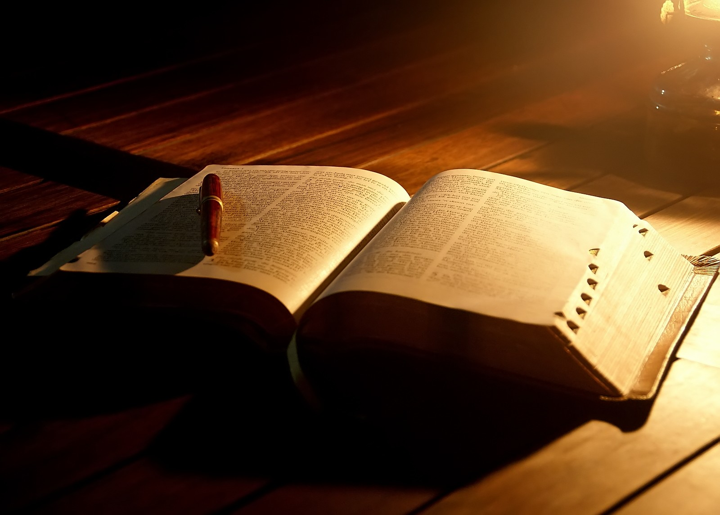
RENEWAL OF A COVENANT
Joshua 24:21-24

Slide 3
A COVENANT – What is it?
An agreement entered into by two or more persons or parties
The promise of God to bless those who obey Him or fulfill some other condition
Law, a written agreement as a contract, under seal
A promise

Slide 4
A COVENANT – What is it?
“For this is the covenant that I will make with the house of Israel after those days, says the LORD: I will put My laws in their mind and write them on their hearts; and I will be their God, and they shall be My people.”
Hebrews 8:10

Slide 5
A COVENANT – What is it?
“For this is the covenant that I will make with the house of Israel after those days, says the LORD: I will put My laws in their mind and write them on their hearts; and I will be their God, and they shall be My people.”
Hebrews 8:10

Slide 6
BOTH PARTIES NEED TO HOLD UP THEIR END OF THE COVENANT…
“in hope of eternal life which God, who cannot lie, promised before time began,”
Titus 1:2

Slide 7
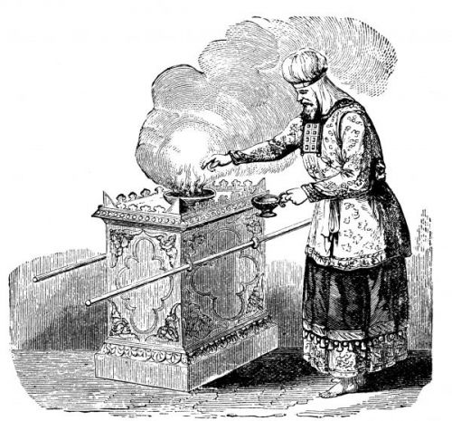
EARLIER TIMES…
Leviticus 23 – Book of Instruction for the Levi priests
- approx. 1490 BC
Feast of Tabernacles (Lev. 23:33-44)
Joshua was a great man (Josh. 24:1-8)
- approx. 1443 BC
Joshua recognized magnitude of the covenant
(Josh. 24:21-24)

Slide 8
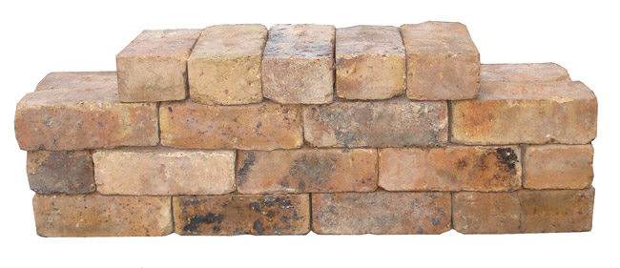
EARLIER TIMES…
Nehemiah was a great man (Neh. 8)
- approx. 445 BC
Nehemiah renewed a covenant (Neh. 9)

Slide 9
RENEWAL OF A COVENANT
Joshua 24:21-24
How are we doing?

Slide 10
END

