Slide 2
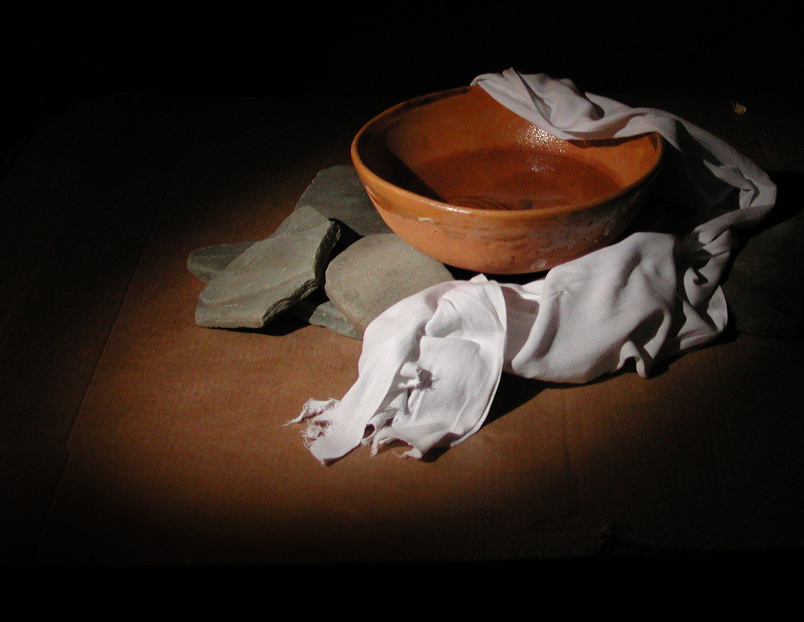
What Does The Lord Require of You?
Micah 6:6-8

Slide 3
What Does The Lord Require of You? Micah 6:8
“He has shown you, O man, what is good; And what does the Lord require of you But to do justly, To love mercy, And to walk humbly with your God?

Slide 4
What Does The Lord Require of You? Micah 6:8
“He has shown you, O man, what is good; And what does the Lord require of you But to do justly, To love mercy, And to walk humbly with your God?

Slide 5
What Does The Lord Require of You?
To Do Good…
“He has shown you, O man, what is good”
Micah 6:8

Slide 6
What Does The Lord Require of You?
To Do Good…
“God is good”
Matthew 19:16-17

Slide 7
What Does The Lord Require of You?
To Do Good…
“His lord said to him, 'Well done, good and faithful servant”
Matthew 25:21

Slide 8
What Does The Lord Require of You?
To Do Good…
“For this is good and acceptable in the sight of God our Savior”
1 Timothy 2:3

Slide 9
What Does The Lord Require of You?
To Do Good…
“And who is he who will harm you if you become followers of what is good?”
1 Peter 3:13

Slide 10
What Does The Lord Require of You?
To Do Good…
“This is a faithful saying, and these things I want you to affirm constantly, that those who have believed in God should be careful to maintain good works. These things are good and profitable to men.”
Titus 3:8

Slide 11
What Does The Lord Require of You? Micah 6:8
“He has shown you, O man, what is good; And what does the Lord require of you But to do justly, To love mercy, And to walk humbly with your God?

Slide 12
What Does The Lord Require of You?
To Do Good
To Do Justly
“judge righteous judgment”
John 7:24

Slide 13
What Does The Lord Require of You?
To Do Good
To Do Justly
“Judge not, that you be not judged.”
Matthew 7:1-2

Slide 14
What Does The Lord Require of You?
To Do Good
To Do Justly
“And as it is appointed for men to die once, but after this the judgment,”
Hebrews 9:27

Slide 15
What Does The Lord Require of You? Micah 6:8
“He has shown you, O man, what is good; And what does the Lord require of you But to do justly, To love mercy, And to walk humbly with your God?

Slide 16
What Does The Lord Require of You?
To Do Good
To Do Justly
To Love Mercy
“Therefore be merciful, just as your Father also is merciful”
Luke 6:36

Slide 17
What Does The Lord Require of You?
To Do Good
To Do Justly
To Love Mercy
“Blessed are the merciful, For they shall obtain mercy.”
Matthew 5:7

Slide 18
What Does The Lord Require of You?
To Do Good
To Do Justly
To Love Mercy
“Blessed are the merciful, For they shall obtain mercy.”
Matthew 5:7

Slide 19
What Does The Lord Require of You?
To Do Good
To Do Justly
To Love Mercy
“For if you forgive men their trespasses, your heavenly Father will also forgive you.”
Matthew 6:14

Slide 20
What Does The Lord Require of You? Micah 6:8
“He has shown you, O man, what is good; And what does the Lord require of you But to do justly, To love mercy, And to walk humbly with your God?

Slide 21
What Does The Lord Require of You?
To Do Good
To Do Justly
To Love Mercy
To Walk Humbly With Thy God
“Therefore let him who thinks he stands take heed lest he fall.”
1 Corinthians 10:12

Slide 22
What Does The Lord Require of You?
To Do Good
To Do Justly
To Love Mercy
To Walk Humbly With Thy God
“For if anyone thinks himself to be something, when he is nothing, he deceives himself.”
Galatians 6:3

Slide 23
What Does The Lord Require of You?
To Do Good
To Do Justly
To Love Mercy
To Walk Humbly With Thy God
“Therefore He says: "God resists the proud, But gives grace to the humble.”
James 4:6

Slide 24
What Does The Lord Require of You?
To Do Good
To Do Justly
To Love Mercy
To Walk Humbly With Thy God
“Humble yourselves in the sight of the Lord, and He will lift you up.”
James 4:10

Slide 25
What Does The Lord Require of You?
To Do Good
To Do Justly
To Love Mercy
To Walk Humbly With Thy God
“God resists the proud, But gives grace to the humble.”
1 Peter 5:5

Slide 26
What Does The Lord Require of You? Micah 6:8
“He has shown you, O man, what is good; And what does the Lord require of you But to do justly, To love mercy, And to walk humbly with your God?

Slide 27
END

