Slide 2
FORGIVENESS
Mark 11:25-26

Slide 3
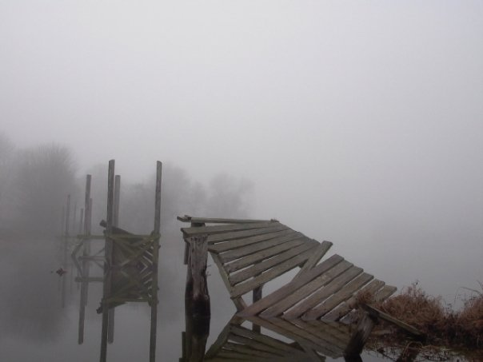
Need to Forgive…
"He who cannot forgive others breaks the bridge over which he must pass himself.“
- George Herbert

Slide 4
Need to Forgive…
“Doing injury puts you below your enemy; revenging one makes you even with him; forgiving sets you above him.“
- Benjamin Franklin

Slide 5
Need to Forgive…
Many a man will be lost, not because he was a liar, adulterer, or murderer, but because he refused to forgive!

Slide 6
Need to Forgive…
“But the Scripture has confined all under sin, that the promise by faith in Jesus Christ might be given to those who believe.”
Galatians 3:22

Slide 7
Need to Forgive…
“If we say that we have no sin, we deceive ourselves, and the truth is not in us. If we confess our sins, He is faithful and just to forgive us our sins and to cleanse us from all unrighteousness. If we say that we have not sinned, we make Him a liar, and His word is not in us.”
1 John 1:8-10

Slide 8
Need to Forgive…
“For if you forgive men their trespasses, your heavenly Father will also forgive you. "But if you do not forgive men their trespasses, neither will your Father forgive your trespasses.”
Matthew 6:14-15

Slide 9
Duty to Forgive…
“Moreover if your brother sins against you, go and tell him his fault between you and him alone. If he hears you, you have gained your brother.”
Matthew 18:15

Slide 10
Duty to Forgive…
“Take heed to yourselves. If your brother sins against you, rebuke him; and if he repents, forgive him.”
Luke 17:3

Slide 11
Duty to Forgive…
“Therefore if you bring your gift to the altar, and there remember that your brother has something against you,…
leave your gift there before the altar, and go your way. First be reconciled to your brother, and then come and offer your gift.”
Matthew 5:23-24

Slide 12
Duty to Forgive…
“bearing with one another, and forgiving one another, if anyone has a complaint against another; even as Christ forgave you, so you also must do.”
Colossians 3:13

Slide 13
The Cost of Forgiveness…
“Oh, do not remember former iniquities against us! Let Your tender mercies come speedily to meet us, For we have been brought very low.”
Psalm 79:8

Slide 14
The Cost of Forgiveness…
“For I will be merciful to their unrighteousness, and their sins and their lawless deeds I will remember no more.”
Hebrews 8:12

Slide 15
The Cost of Forgiveness…
“But there shall by no means enter it anything that defiles, or causes an abomination or a lie, but only those who are written in the Lamb's Book of Life.”
Revelation 21:27

Slide 16
The Cost of Forgiveness…
“But we see Jesus, who was made a little lower than the angels, for the suffering of death crowned with glory and honor, that He, by the grace of God, might taste death for everyone.”
Hebrews 2:9

Slide 17
The Cost of Forgiveness…
“This is a faithful saying and worthy of all acceptance, that Christ Jesus came into the world to save sinners, of whom I am chief.”
1 Timothy 1:15

Slide 18
The Cost of Forgiveness…
“And whenever you stand praying, if you have anything against anyone, forgive him, that your Father in heaven may also forgive you your trespasses. But if you do not forgive, neither will your Father in heaven forgive your trespasses.”
Mark 11:25-26

Slide 19
END

