Slide 3
Do you think
the manufacturer packaged these this way?

Slide 4
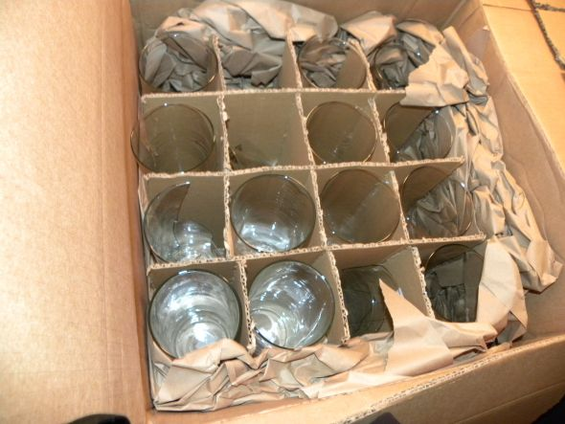
Do you think they were put in the box broken?

Slide 5
“And so it was, as her soul was departing
(for she died)...”
Genesis 35:18

Slide 6
“Then the dust will return to the earth as it was, And the spirit will return to God who gave it.”
Ecclesiastes 12:7

Slide 7
THE SOUL IS TOO PRECIOUS
to neglect the watchwords

Slide 8
SIGNIFIES THE OBJECT IS OF VALUE
It is worth more than the whole world
“For what will it profit a man if he gains the whole world, and loses his own soul? Or what will a man give in exchange for his soul?”
Mark 8:36-37

Slide 9
SIGNIFIES THE OBJECT IS OF VALUE
It is worth more than the whole world (Mark 8:36-37)
It is worth so much, Jesus came to save it
“And she will bring forth a Son, and you shall call His name JESUS, for He will save His people from their sins.”
Matthew 1:21

Slide 10
SIGNIFIES THE OBJECT IS OF VALUE
It is worth more than the whole world (Mark 8:36-37)
It is worth so much, Jesus came to save it (Mat. 1:21)
It is so precious, God gave His Son on behalf of it
“For God so loved the world that He gave His only begotten Son, that whoever believes in Him should not perish but have everlasting life.”
John 3:16

Slide 11
SIGNIFIES THE OBJECT IS OF VALUE
It is worth more than the whole world (Mark 8:36-37)
It is worth so much, Jesus came to save it (Mat. 1:21)
It is so precious, God gave His Son on behalf of it (John 3:16)
It is so valuable that Christ died for it

Slide 12
INDICATES THE OBJECT CAN BE DAMAGED
This is true of the soul – it can be lost because of sin
“Then Jesus said to them again, "I am going away, and you will seek Me, and will die in your sin. Where I go you cannot come.”
John 8:21

Slide 13
INDICATES THE OBJECT CAN BE DAMAGED
This is true of the soul – it can be lost because of sin
The majority will be lost
“Enter by the narrow gate; for wide is the gate and broad is the way that leads to destruction, and there are many who go in by it. Because narrow is the gate and difficult is the way which leads to life, and there are few who find it.”
Matthew 7:13-14

Slide 14
ARE WORDS OF CAUTION
Should be cautious in handling the word of God
Should be cautious in believing teachers and preachers
Certainly need to be cautious in our living

Slide 15
In Spite of the Value of the Soul, many people are indifferent towards it…

Slide 16
Dept. of Psychology at Vassar College
From your experience, what would you say are the most important things to you?
What sort of things mean most to you?
What things are you most interested in?
What things do you care about most?

Slide 17
Dept. of Psychology at Vassar College
From your experience, what would you say are the most important things to you?
What sort of things mean most to you?
What things are you most interested in?
What things do you care about most?

Slide 18
Dept. of Psychology at Vassar College
From your experience, what would you say are the most important things to you?
What sort of things mean most to you?
What things are you most interested in?
What things do you care about most?

Slide 19
Dept. of Psychology at Vassar College
From your experience, what would you say are the most important things to you?
What sort of things mean most to you?
What things are you most interested in?
What things do you care about most?

Slide 20
Dept. of Psychology at Vassar College
Here are some of the Results:
56% stated Economic Security
46% stated Home and Family Life
25% stated Liberty and Freedom
13% stated World Peace
10% stated Education
8% stated Religion
4% stated Decency and Morality
2% stated Being a Good Citizen

Slide 21
Dept. of Psychology at Vassar College
Here are some of the Results:
56% stated Economic Security
46% stated Home and Family Life
25% stated Liberty and Freedom
13% stated World Peace
10% stated Education
8% stated Religion
4% stated Decency and Morality
2% stated Being a Good Citizen

Slide 22
Dept. of Psychology at Vassar College
Here are some of the Results:
56% stated Economic Security
46% stated Home and Family Life
25% stated Liberty and Freedom
13% stated World Peace
10% stated Education
8% stated Religion
4% stated Decency and Morality
2% stated Being a Good Citizen

Slide 23
Dept. of Psychology at Vassar College
Here are some of the Results:
56% stated Economic Security
46% stated Home and Family Life
25% stated Liberty and Freedom
13% stated World Peace
10% stated Education
8% stated Religion
4% stated Decency and Morality
2% stated Being a Good Citizen

Slide 24
Dept. of Psychology at Vassar College
Here are some of the Results:
56% stated Economic Security
46% stated Home and Family Life
25% stated Liberty and Freedom
13% stated World Peace
10% stated Education
8% stated Religion
4% stated Decency and Morality
2% stated Being a Good Citizen
“And He said to them, "Take heed and beware of covetousness, for one's life does not consist in the abundance of the
things he possesses.”
Luke 12:15

Slide 25
WE LOOK TO JESUS AS OUR EXAMPLE
Was about his Father’s business (Luke 2:49)
Was baptized to fulfill all righteousness (Mat. 3:13-17)
It was his custom to worship (Luke 4:16)
He prayed (Luke 6:12)
Was tempted in all points like us- did not sin (Heb. 4:15)

Slide 26
WE LOOK TO JESUS AS OUR EXAMPLE
No matter what our problem is, Jesus faced it (Heb. 4:15)
- Physical suffering (Mat. 27)
- If your heart bleeds (John 11:35)
- If you have no financial security (Mat. 8:20)
- Have friends forsaken you (Mat. 26:56)
- Facing the opposition (Mat. 23)
- Have enemies misrepresented you (Mat. 26:60)

