Slide 2
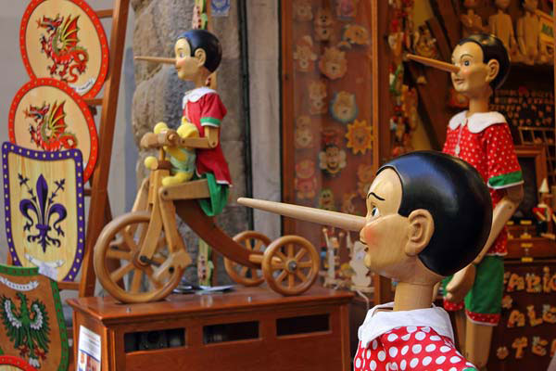
The Pinocchio Effect

Slide 3
“For God will bring every work into judgment, Including every secret thing, Whether good or evil.”
Ecclesiastes 12:14
The Pinocchio Effect

Slide 4
If we do no wrong…
The Pinocchio Effect

Slide 5
“And have no fellowship with the unfruitful works of darkness,
but rather expose them.”
Ephesians 5:11
The Pinocchio Effect

Slide 6
“But all things that are exposed are made manifest by the light, for whatever makes manifest is light.”
Ephesians 5:13

Slide 7
“manifest”
Readily perceived by the eye or understanding,
Evident, Obvious, Apparent, Plain,
To prove beyond question of doubt

Slide 8
What happens when someone is exposed?
The Pinocchio Effect

Slide 9
“Were they ashamed when they had committed abomination? No! They were not at all ashamed; Nor did they know how to blush. Therefore they shall fall among those who fall; At the time I punish them, They shall be cast down," says the LORD.”
Jeremiah 6:15

Slide 10
“But all things that are exposed are made manifest by the light, for whatever makes manifest is light.”
Ephesians 5:13

Slide 11
Transdermal Optical Imaging
The Pinocchio Effect

Slide 12
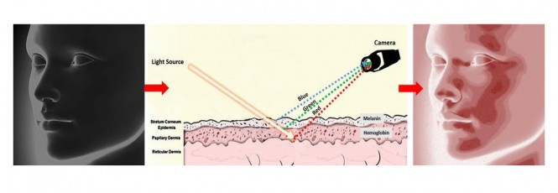
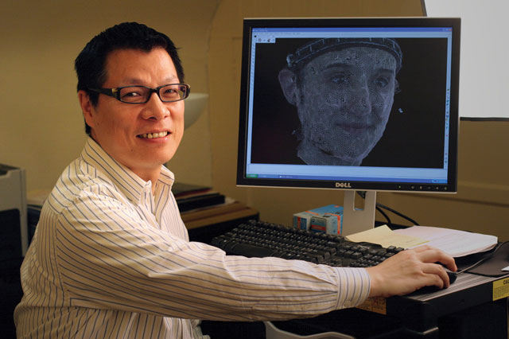
“I’ve studied human face processing and deception for over two decades,” says Lee. “To facilitate this research, I worked with my postdoctoral fellow, Dr. Paul Zheng, to develop a new imaging technology that uses a conventional video camera to reveal facial blood flow changes when people are experiencing various hidden emotions, including emotions associated with lying. We call our technology Transdermal Optical Imaging. Although it was originally developed to study face processing and deception, this versatile technology has many, many business applications, including to marketing research.”
The Pinocchio Effect

Slide 13
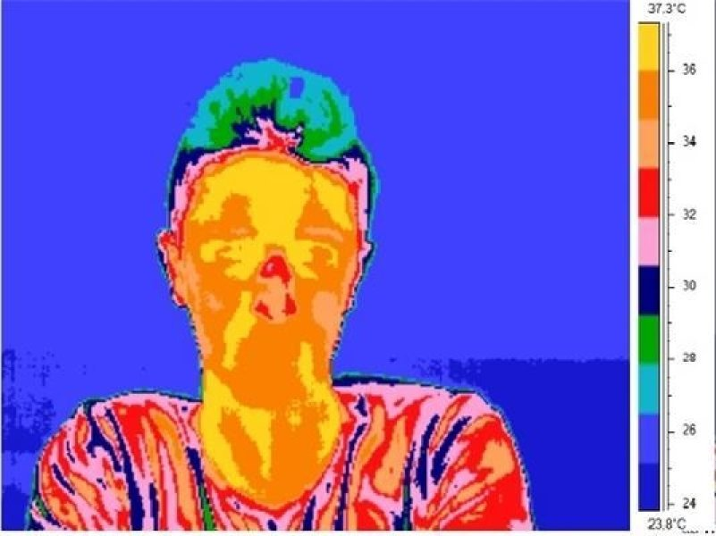
When a person lies, they experience a "Pinocchio effect," which is an increase in the temperature around the nose and in the orbital muscle in the inner corner of the eye. In addition, when we perform a considerable mental effort our face temperature drops, and when we have an anxiety attack our face temperature rises.
Dec 3, 2012
The Pinocchio Effect

Slide 14
A technology company is developing a lie detector app for smartphones that could be used by parents, teachers - and internet daters. The app measures blood flow in the face to assess whether or not you are telling the truth
(stock image used)

Slide 15
The Pinocchio Effect
“But all things that are exposed are made manifest by the light, for whatever makes manifest is light.”
Ephesians 5:13

Slide 16
Being exposed is no fun,
the end is not worth the attempt to
deceive or cover up.
The Pinocchio Effect

Slide 17
Being exposed is no fun, and the end is not worth the attempt to
deceive or cover up.
“For God will bring every work into judgment, Including every secret thing, Whether good or evil.”
Ecclesiastes 12:14

Slide 18
The Pinocchio Effect

