Slide 2
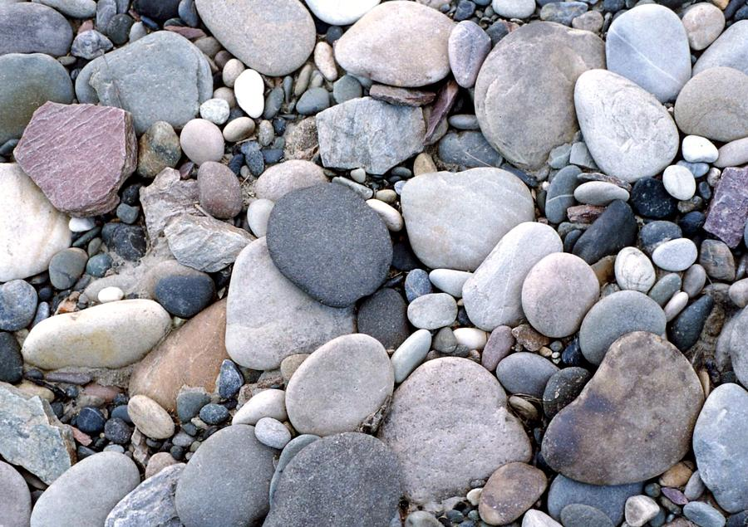
THROWING STONES

Slide 3
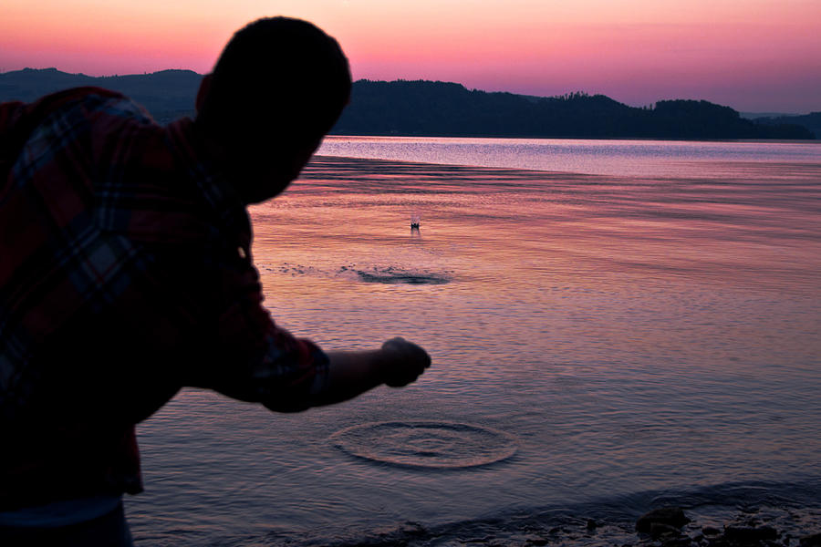

Slide 4
This series of events can also be applied to things we do in our life

Slide 5
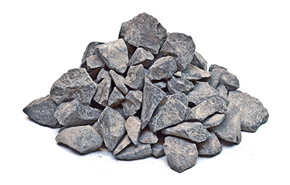
STEPHEN – ACTS 7:57-60
Stephen was preaching Christ to the council
They rejected him
The “ripples” from their conduct scattered the disciples

Slide 6
STEPHEN – ACTS 7:57-60
“The stone often recoils on the head of the thrower”
Queen Elizabeth 1

Slide 7
ADULTERESS WOMAN – JOHN 8:1-11
We must be careful when we begin to accuse others of their wrongdoings
All have sinned
Must be patient and must be able to look inward

Slide 8
ADULTERESS WOMAN – JOHN 8:1-11
“When I was a child, I spoke as a child, I understood as a child, I thought as a child; but when I became a man, I put away childish things. For now we see in a mirror, dimly, but then face to face. Now I know in part, but then I shall know just as I also am known. And now abide faith, hope, love, these three; but the greatest of these is love.”
1 Corinthians 13:11-13

Slide 9
ADULTERESS WOMAN – JOHN 8:1-11
“But be doers of the word, and not hearers only, deceiving yourselves. For if anyone is a hearer of the word and not a doer, he is like a man observing his natural face in a mirror; for he observes himself, goes away, and immediately forgets what kind of man he was.”
James 1:22-24

Slide 10
ADULTERESS WOMAN – JOHN 8:1-11
“But we all, with unveiled face, beholding as in a mirror the glory of the Lord, are being transformed into the same image from glory to glory, just as by the Spirit of the Lord.”
2 Corinthians 3:18

Slide 11
ARE YOU OUT TO HURT, OR TO HELP?
“Anger is as a stone cast into a wasp’s nest”

Slide 12
ARE YOU OUT TO HURT, OR TO HELP?
This depends on your attitude and how you handle the stones
We can throw to harm
We can use to help –
“build up”

Slide 13
Our life is like throwing stones into the pond

Slide 14
Our life is like throwing stones into the pond
“When Jesus had raised Himself up and saw no one but the woman, He said to her, "Woman, where are those accusers of yours? Has no one condemned you?" She said, "No one, Lord." And Jesus said to her, "Neither do I condemn you; go and sin no more.”
John 8:10-11

Slide 15
What effect will your life have on others?
THROWING STONES

