Slide 2
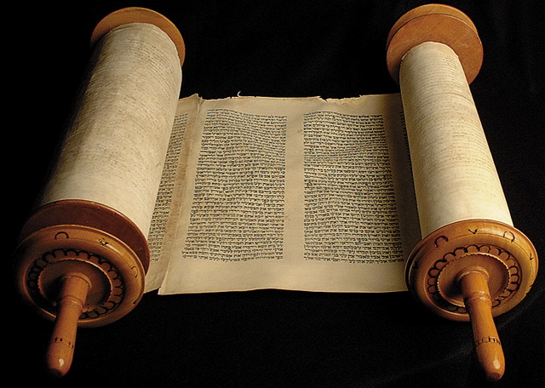
“Write This For a Memorial in the Book”

Slide 3
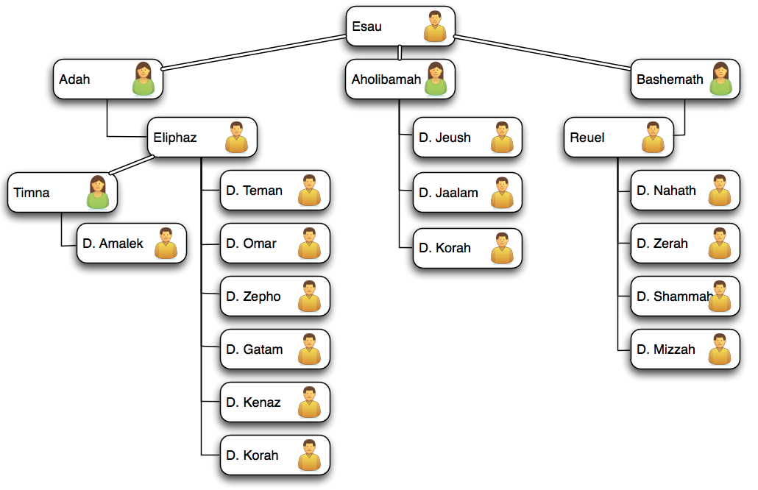

Slide 6
“Then the Amalekites and the Canaanites who dwelt in that mountain came down and attacked them, and drove them back as far as Hormah.”
Numbers 14:45

Slide 7
“Then he gathered to himself the people of Ammon and Amalek, went and defeated Israel, and took possession of the City of Palms.”
Judges 3:13

Slide 8
“So it was, whenever Israel had sown, Midianites would come up; also Amalekites and the people of the East would come up against them.”
Judges 6:3

Slide 9
“Thus says the LORD of hosts: 'I will punish Amalek for what he did to Israel, how he ambushed him on the way when he came up from Egypt. Now go and attack Amalek, and utterly destroy all that they have, and do not spare them. But kill both man and woman, infant and nursing child, ox and sheep,
camel and donkey.”
1 Samuel 15:2-3

Slide 10
“For rebellion is as the sin of witchcraft, And stubbornness is as iniquity and idolatry. Because you have rejected the word of the LORD, He also has rejected you from being king.”
1 Samuel 15:23

Slide 11
“Now some of them, five hundred men of the sons of Simeon, went to Mount Seir, having as their captains Pelatiah, Neariah, Rephaiah, and Uzziel, the sons of Ishi. And they defeated the rest of the Amalekites who had escaped. They have dwelt there to this day.”
1 Chronicles 4:42-43

Slide 12
“I will bless those who bless you, And I will curse him who curses you; And in you all the families of the earth shall be blessed.”
Genesis 12:3

Slide 13
Lessons We Can Garner From the Amalekites

Slide 14
“Write This For a Memorial in the Book”

