Slide 1
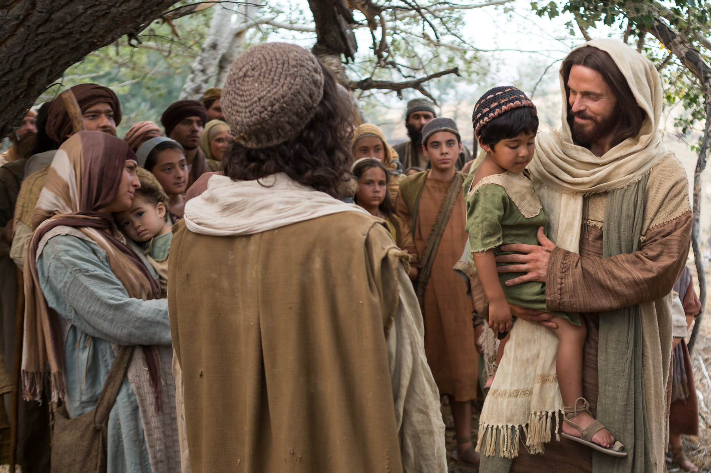
Let the Little Children Come to Me

Slide 2
See Children as Precious Blessings from the Lord
Children come from the Lord Gen. 33:5
Children are a blessing Ps. 127:3

Slide 3
Teach Children about the Lord
The path they should take Prov. 22:6
Create teaching moments Deut. 6:7
Children: Pay attention and obey! Eph. 6:1-4

Slide 4
Start Early
Samuel 1 Sam. 1:21-28
Daniel Daniel 1:3-4
Timothy 2 Tim. 3:14-15

Slide 5
Let the Children Come See Jesus
Let them discover Jesus Jn. 1:44-46
Let them be blessed by Jesus Mk. 10:13-16

Slide 6
Will You Come to Jesus?

