Slide 2
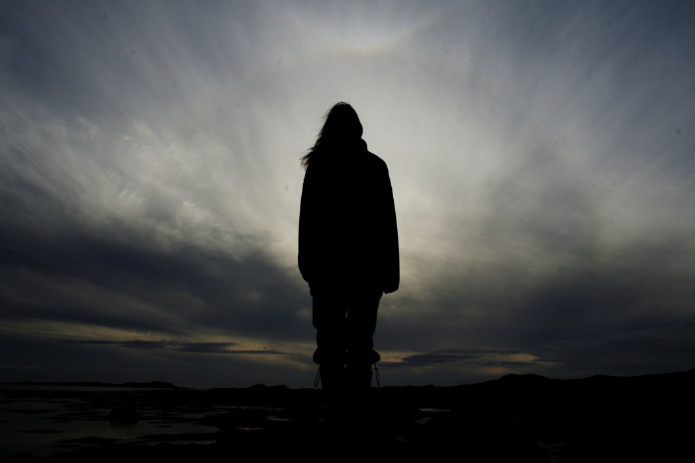
“THERE WAS NO MORE SPIRIT”
1 Kings 10:1-3

Slide 3
“THERE WAS NO MORE SPIRIT”
CHALLENGING OUR OWN FAITH
Satan challenges God every day (so do we)
So did the Queen of Sheba regarding Solomon
Solomon answered all her questions
The Queen saw his greatness
What the Queen saw was much greater than imagined!

Slide 4
“THERE WAS NO MORE SPIRIT”
MUCH TO OFFER…
The Queen had much to offer
We too have much to offer
The Queen realized that God loved His people

Slide 5
“THERE WAS NO MORE SPIRIT”
Are you prepared to give God what He rightly deserves?
God Still Loves
His People

